Slide 1
Clusters and Technology Spillovers in the UK Defence Sector
Prof Jen Nelles (Oxford Brookes)
Dr Adam Brown (Cambridge Econometrics)
July 17th 2026

Slide 2
Overview of Approach
Is the UK defence industry organised into defence-specific clusters?
Or are defence firms integrated into civil clusters?
Mapping and Analysing MOD Supply Chain
Dual Use Theoretical Framework
What are the key potential technology spillovers between defence and civil sectors?
Analysing Dual Use Opportunities
Are these being realised?
If so, where and to what outcome?
If not, what can we do about it?
Notes:
AF

Slide 3
Mapping and Analysing the MOD Supply Chain

Slide 4

Data Sources (and issues...)
Joint Supply Chain Accreditation Register (JOSCAR)
  List of suppliers that have worked with MOD (or plan to)
  ~5,000 companies
TheDataCity RTICs
  60 RTICs (excluding new defence) subdivided into 485 “verticals”
  1807 (32%) firm overlap with our dataset
  Used to characterise sectors, clusters, and explore dual use

Slide 5
Defence Sector Categorisation Framework
Air Platforms
Training & Welfare
Electronics & Optics
Machinery
Professional Services
Chemicals & Materials
Land Platforms
Marine Platforms
Complex Weaponry
C4ISR
Logistics & Bases
Personal Equipment
Front Line Capabilities
Support Capabilities
General Supply Chain

Slide 6
Data: JOSCAR categories and relationships between them
12 categories
4 “front-line” capabilities: air, land, marine, weaponry
4 “critical support” capabilities: logistics, C4ISR, personal equipment, personal welfare
4: “upstream supply” capabilities: chemicals, machinery, electronics, professional services
Companies can belong to more than one category
Wide variation in # of firms (professional services largest, weaponry smallest)
Strong overlaps in some (e.g., air, marine, and land platforms) but weaker in others (e.g., weaponry)

Slide 7
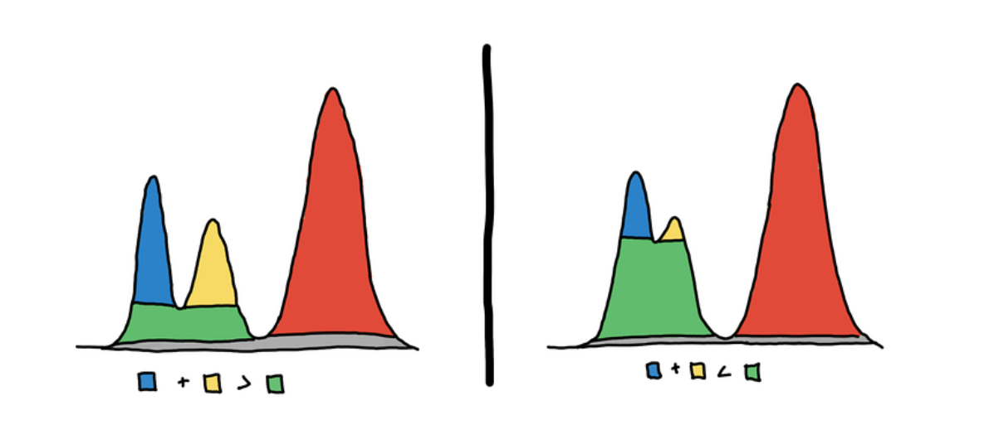
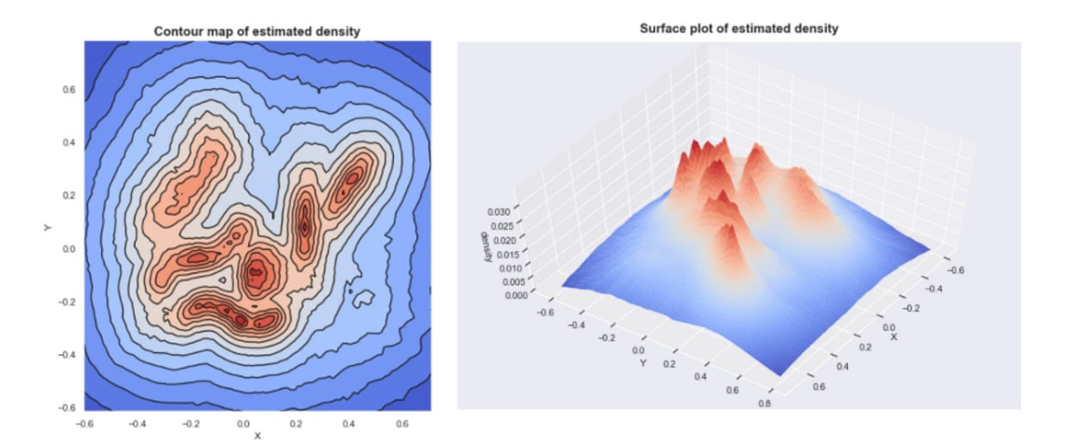
Cluster methodology
Reclassified JOSCAR data into 12 categories
HDBSCAN (Hierarchical Density-Based Spatial Clustering of Applications with Noise)
Vetting and adjustment
  Focus on manageable number of clusters
  Adjusting spacing and overlaps
  Sense checked geographies
  Acknowledging MOD clusters might not present the same as civil ones

Slide 8
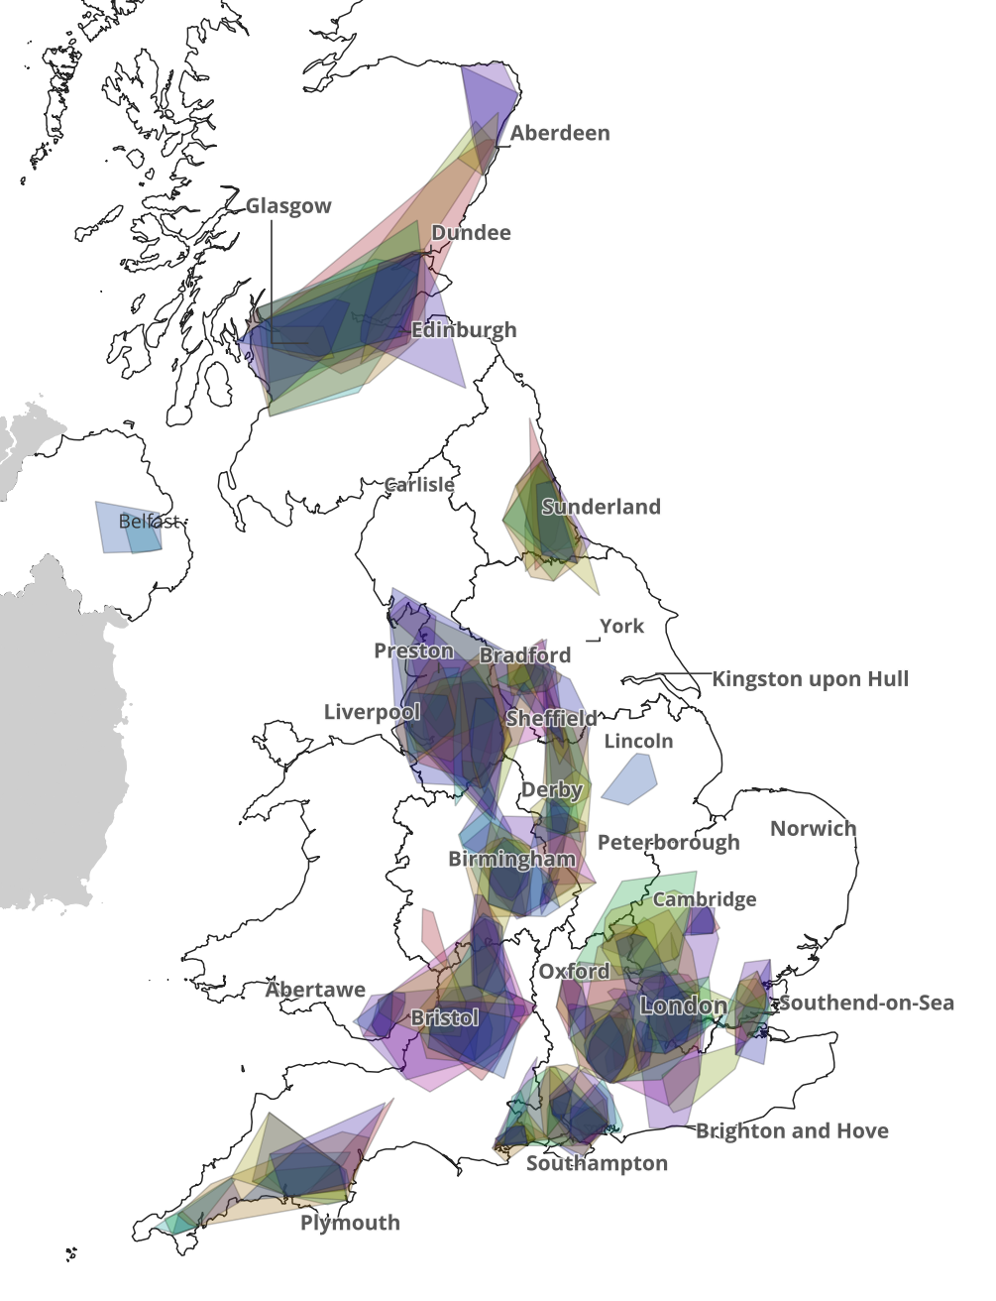
Exploring MOD clusters in places
Chevron bullet point style
  Second bullet
Not many surprises
Lots of spatial overlap between JOSCAR sectors
Geographies become larger and some distinctive areas of interest emerge
Others become more complicated (e.g., Golden Triangle)
But, some caveats; The clusters are:
  Not the same sizes/significance in terms of employment, income from MOD, turnover etc.
  Not necessarily integrated/interacting with one another
Understanding significance requires more analysis

Slide 9
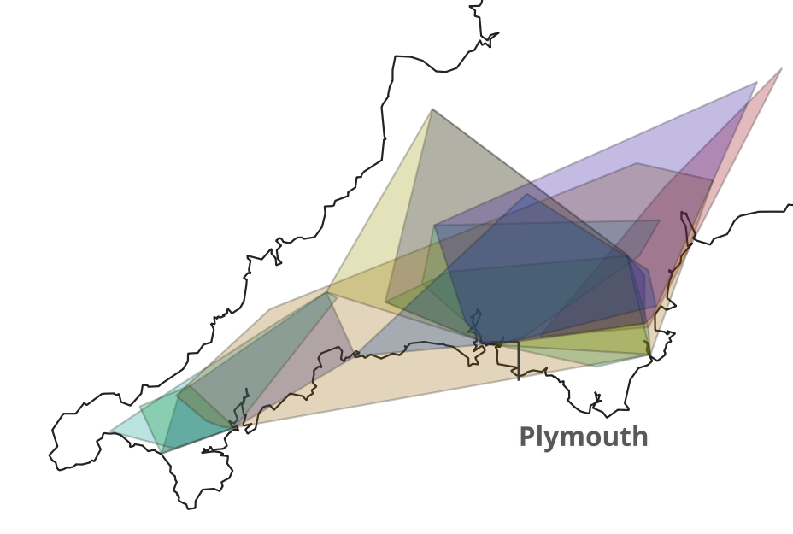
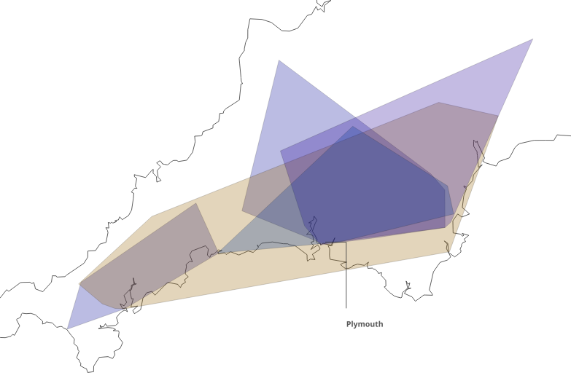
Zooming in: South West
Chevron bullet point style
  Second bullet
Has some representation from many sectors (not weaponry, air, land, electrical)
2 clear subgroupings – Devon & Cornwall
4 "main" clusters all centred on Plymouth
Growth strategies could support all clusters, most significant clusters, OR explore opportunities for synergies
  Marine 3 overlaps with Mechanical 1, Materials 2, Personal equipment 1
Professional services 1
Marine 3
Training & professional services 3
Machinery & mechanical 1
Notes:
Training: Castle Air Ltd (helicopter/rotory craft academy); Devonport Royal Dockyard Ltd (Naval base management)

Slide 10
Dual Use Theoretical Framework

Slide 11
Different Layers of Dual Use/Purpose
Dual Purpose Products, eg Solar Arrays
Dual Purpose Clusters, eg SW Marine Cluster
Dual Purpose Firms, eg Rolls Royce

Slide 12
Dual use Technology Theoretical Framework
W. Brian Arthur: “A technology … is a programming or orchestration of phenomena to our use.”
Fundamental R&D
General Purpose Technologies
Specific Defence Applications
Specific Civil Applications
Study a natural phenomenon….. Work out Principles of Programming and Orchestration….. Apply to Specific Purposes

Slide 13
Spillover Channels
Direct Spillovers between Defence Uses and Civil Equivalents
Indirect Channels via GPTs
Fundamental R&D
General Purpose Technologies
Defence Applications
Civil Applications
Notes:
AF

Slide 14









Example of Direct Spillovers – Dual Use Firms
 | Land Platforms | Air Platforms | Marine Platforms | Weaponry | C4ISR | Logistics & Bases | Training & Welfare | Personal Equipment
Company | Permali Gloucester Limited | FLIR Defence | Oldham Engineering | CCP Gransden | Telent | Premier Modular | Agility3 | Pauley
MOD application | Armour, composite molding, engine/fuel tank protection | Unmanned aerial systems, targeting and optics | Ship motor base, munitions lift platforms, weapons trainers | Composite launch canisters | Base secure comms infrastructure, cybersecurity, app solutions | Modular defence training, living, and operational facilities | Defence training immersive simulators | Wearable augmented and mixed reality gear
Civilian application | Composite components (offshore wind, medical, energy, textiles, aerospace, motorsport) | Precision optics, thermal imaging, surveillance, optical chemical and gas detection | Nuclear shielding & robotics, offshore components, cable laying equipment, rail cranes | Aerospace, transport, offshore casings; luxury marine interiors; pressure vessels | IT solutions for emergency services, energy & utilities, higher education, infrastructure | Modular environments for education, commercial, industrial, justice, healthcare, residential | Commercial, emergency, and rail driving training simulators, virtual experiences, VR design tools | Safety training tools for rail, energy, education; immersive environments for commercial, real estate

Slide 15
To Identify Indirect Spillovers we must first develop a General Purpose Technology Framework – based on Arthur’s definition
Categories of Natural Phenomena
 | Energy | Information | Physical Material | Biological Organisms
“Programming”: Generation & Transformation | eg Solar | eg AI | eg Nanoscience | eg Genetic Engineering
“Orchestration”: Control & Transference | eg Heat Pumps | eg Advanced Sensors | eg Robotics | eg Pharmaceutics
Categories of Intervention

Slide 16
Example Defence Applications of General Purpose Technologies
Technology Area | Land Platforms | Air Platforms | Marine Platforms | Complex Weaponry | C4ISR | Logistics | Training & Welfare | Personal Equipment
Information Programming (AI, cryptography, advanced compute) | AI-enabled vehicle diagnostics; route-planning AI for armoured vehicles | AI pilot-assist; autonomous navigation for UAVs | AI for collision avoidance on vessels; quantum geolocation | AI-assisted targeting; guidance optimisation | Automated threat analysis; encrypted comms (quantum) | Inventory optimisation; predictive supply chain analytics | AI-driven personalised training plans; secure health data analytics | AI-assisted decision aids; smart wearables
Information Orchestration (VR/AR, advanced sensors, satellites) | Ground radars; battlefield surveillance sensors | ISR pods; synthetic aperture radar (SAR) on aircraft | Sonar arrays; ship-mounted multi-spectral sensors | Smart weapon sights; target-tracking sensors | Satellite ISR; signals intelligence (SIGINT) systems | Supply chain tracking sensors; environment sensors | VR training environments; AR assisted medical and wellness tools | Integrated body-worn sensors, heads-up displays
Materials Programming (composites, smart materials) | Composite armour; blast-resistant materials | Lightweight airframe composites; radar-absorbing materials | Corrosion-resistant ship hull materials; stealth coatings | Heat-resistant missile casings; lightweight barrels | Hardened communication shelters | Durable packaging; lightweight load-carrying gear | Smart fabrics for medical dressings | Lightweight ballistic protection; impact-absorbing gear
Materials Orchestration (robotics, autonomous systems) | Unmanned ground vehicles (UGVs) for reconnaissance or EOD | Autonomous UAV swarm systems; drone wingmen | Uncrewed surface/underwater vehicles (USVs/UUVs) | Automated loading systems; robotic ammo handling | Robotic sensor towers; automated relay drones | Autonomous cargo movers; robotic warehousing | Robotic training simulators; automated rehabilitation and physio devices | Powered exoskeletons; robotic load-bearing and assistive devices
Energy Systems (novel energy generation, storage, transmission) | Advanced batteries for vehicles; hybrid-electric armour | High-density power for UAV endurance; portable energy pods | Alternative fuels for ships, incl nuclear | Directed energy weapon power modules; improved battery packs | Mobile microgrids for command posts | Portable solar units; sustainable base power | Energy-efficient training facilities; portable power for medical equipment | Long-life batteries for wearables; energy-harvesting clothing
Biological Systems (bio-sensors, bio-materials) | Soldier health biosensors; rapid medical diagnostics | Pilot fatigue monitoring; biomarker detection | Crew health monitoring systems | Improved biopolymer explosives; biologically safe propellants | Biometric authentication systems, distributed bio-sensors | Biodegradable materials for supply; enhanced rations | Preventive health monitoring; personalised medicine | Smart textiles with biosensing

Slide 17
Findings and Use Cases

Slide 18
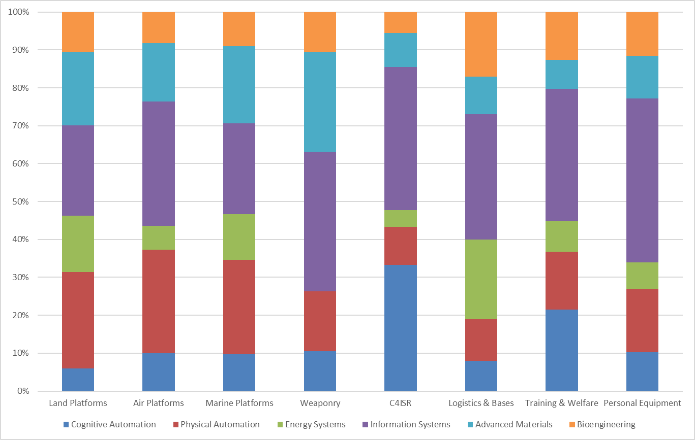
JOSCAR Capabilities x GPT Categories
Biological Systems
Material Programming
Information Orchestration
Energy Systems
Material Orchestration
Information Programming
Notes:
C4ISR has the largest overlap with Cognitive Automation and Information Systems
Other categories have overlaps with others
Energy is most strongly represented in Logistics & Bases

Slide 19
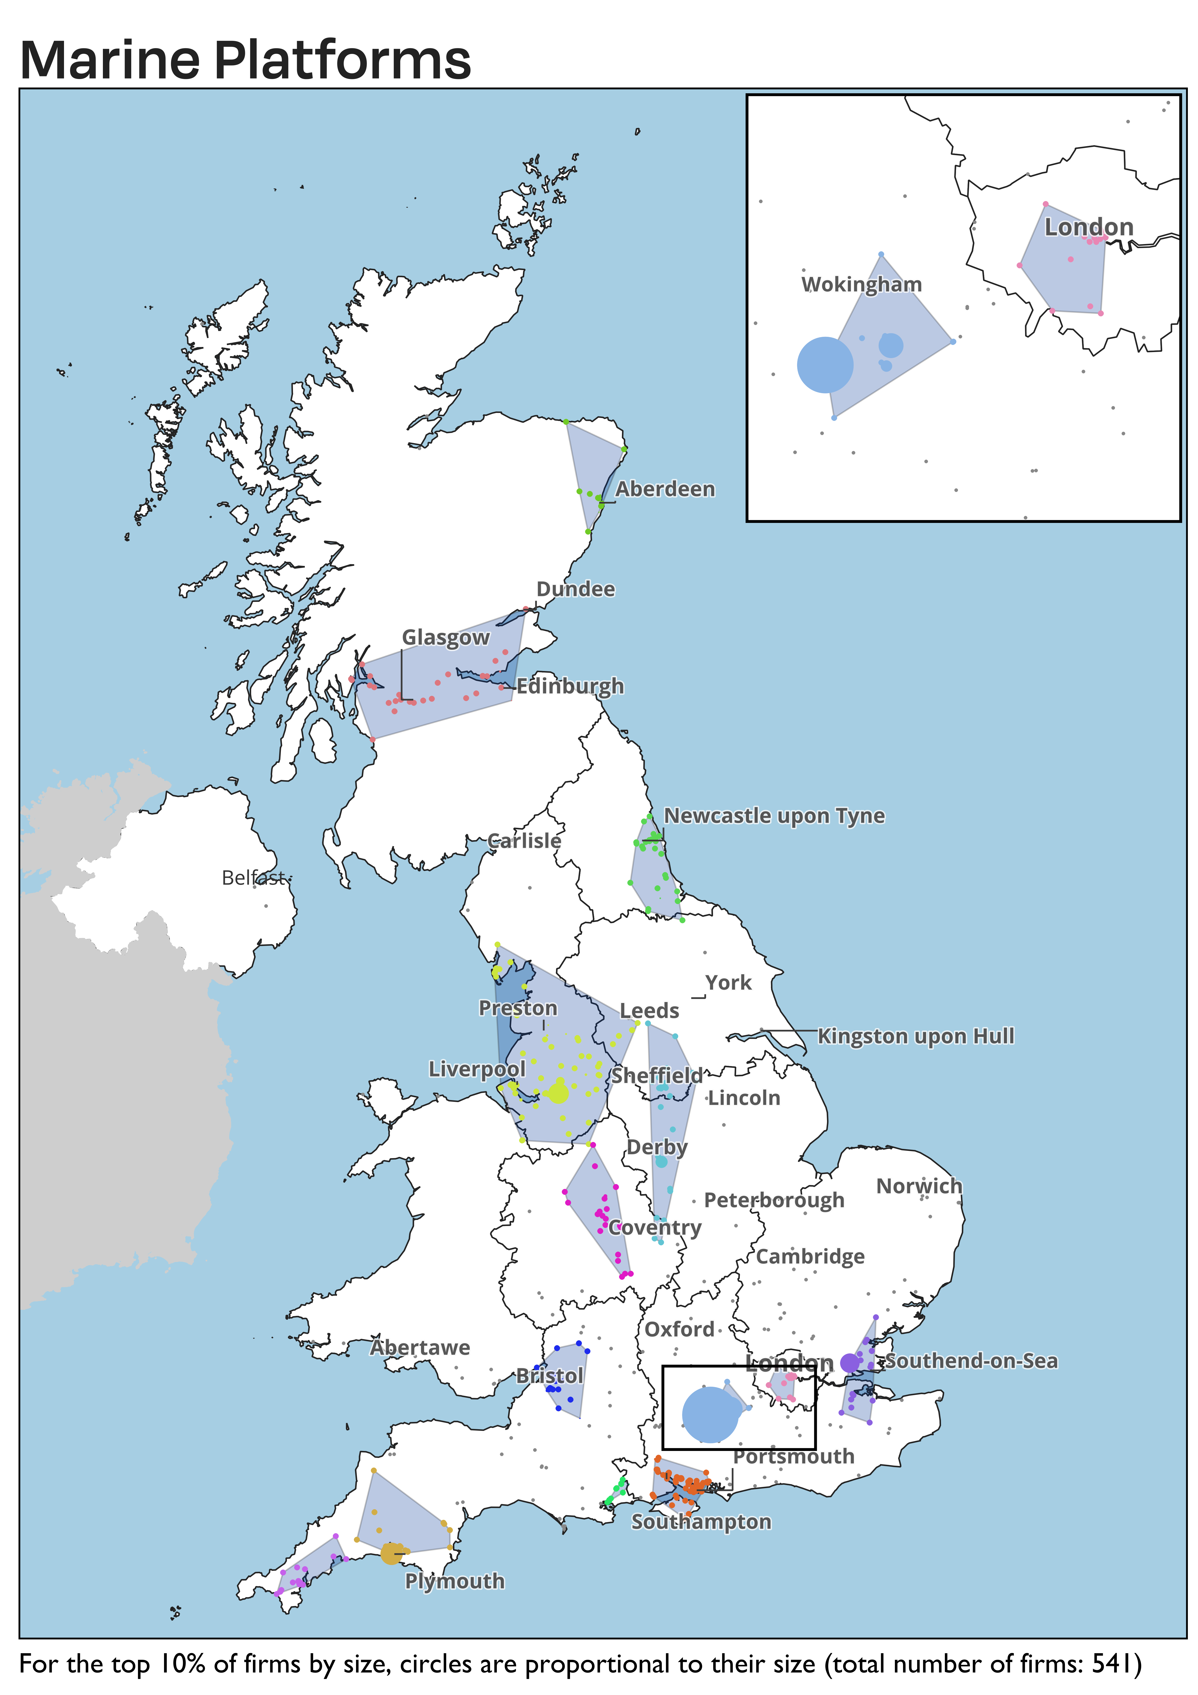
Clusters x GPT: Marine platforms
Greater Manchester
Energy
Berkshire
Information gathering
Hampshire
Physical automation

Slide 20
Top findings
Not surprisingly, MOD clusters tend to be located in many of the same places as civil clusters (DSIT) - e.g., focused around major metro areas. Although, they often stretch geographically to incorporate more remote locations because of specific geographical needs (e.g., Barrow is part of Manchester marine platforms).
When looking at the established (powerhouse and solid) and emerging (prospects) clusters, it is interesting that, in this sample, the NW and Midlands come out as having more established one while prospects tend to be in the South (Bristol, Solent, Ox-Cam, London exurbs).
Defence clusters overlap geographically – very few places have just one cluster (although important to note that not every place has every cluster). This means that it is important to consider the cluster mix when thinking about investment priorities.
Defence clusters also overlap functionally – many of the same firms are in several different clusters. Again, this suggests that we think about relationships between clusters and what agglomeration economies underpin them (e.g., specialised labour, infrastructure, etc etc).
We see widely different types of dual-use clusters – some are literally clusters of dual-use firms, others are comprised of distinct but interacting subgroups of civil and defence-focused organisations.
Clusters within the same capability category can be quite different – marine platforms clusters in some places are dominated by advanced manufacturing while others have a more diverse base with firms that are also involved in other sectors e.g., net zero, energy generation, advanced systems, sensors, space economy).
The lesson here is that there is no one size fits all policy for clusters that are thematically similar but perform different functions in supply chains. This is important because it moves us away from places being in competition with one another on similar clusters and towards a focus on leveraging complementarities.

Slide 21
Mapping a 3-way relationship to inform MOD investments
If the MOD wants to invest in a specific capability, what technologies spillovers might it expect, and which places might benefit?
If the MOD were to fund research in a specific technology, which places have the strongest connections to defence, and which specific capabilities might improve as a result?
If the MOD wants to invest in a specific place, what capability improvements and technology benefits might it expect?
Capabilities
Place
Technologies

Slide 22
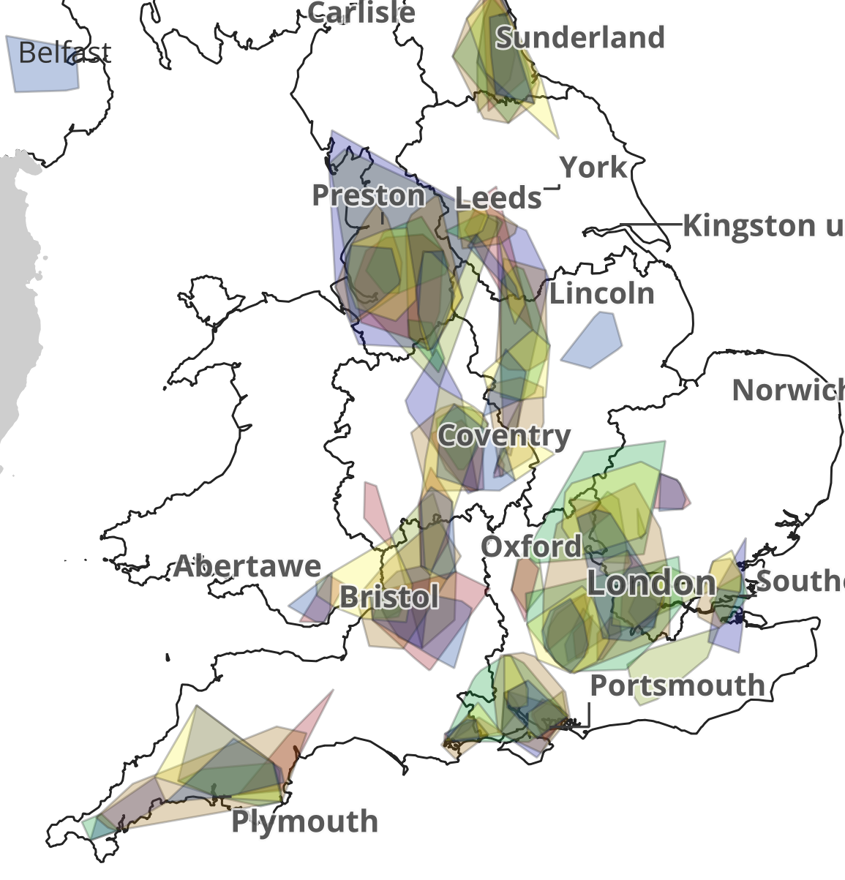
Overlaps create opportunities for multiple approaches
One cluster – one focus: Invest in the most promising cluster in a place of interest to build competence and maximise spillovers in one set of industries.
  Strength: Intense focus simplifies planning/activities and accountability/impact tracking.
  Weaknesses: May not effectively take advantage of complementary industries in the same place. Limited scope to explore complementary links between places.
One place – broad focus: Invest in a place, design activities to support development of multiple overlapping clusters and spillovers.
  Strengths: Focuses on developing synergies and leveraging dual use across industries.
  Weaknesses: Multiple industries and activities can make tracking more difficult. Also limited scope to explore complementary links between places.,
Strategic focus on cluster type or input – targeting multiple places: Develop a strategy to support clusters in a specific part of the supply chain or developing/applying specific strategic technologies (e.g., AI or quantum). Understand links between places.
  Strengths: Focus on maximising benefits across the UK innovation system opens up greater possibilities for collaboration and development. Targets tangible objectives for technology and capability development.
  Weaknesses: Potential to miss cross industry/cluster synergies in focus on specific industry/technology and applications.

Slide 23
Work Ongoing
Phase 2: Cluster Pilot Study – framework and metrics (ongoing)
  The Defence Growth Deals cluster evaluation framework contains a set of metrics to measure progress on five DGD objectives.
  We are currently testing the framework on defence clusters in Bristol before scaling to other places.
Phase 3: Dashboard (Sept)
  The final phase will produce an interactive dashboard collecting cluster analysis data

Slide 24


Thank you
alb@camecon.com

