Slide 1
Bringing Back (Advanced) Manufacturing: Will Reshoring of Advanced Manufacturing Drive Regional Competitiveness in Australia?
Sharif Rasel
Paul Kalfadellis
Hamish Gamble

Slide 2
Presentation outline
Context of the study
Literature review
Hypothesis of the study
Methods and findings

Slide 3
Context of the study
New Industrial Policy: Budget 2024–25
  ‘Future Made in Australia’ budget measures encompass a $22.7 billion incentives
The government aims to spend billions of dollars of public money to revive the manufacturing sector in Australia.
The policy has faced significant criticism for 'picking winners' or having a 'high economic cost'.
The impact of public policy supporting the reshoring of advanced manufacturing on regional competitiveness has not been adequately addressed.

Slide 4
Advanced manufacturing and regional competitiveness (1)
Although subsidising is a ‘low-road’ policy, advanced manufacturing is knowledge-intensive
  As such supporting the growth of advanced manufacturing is a high-road policy to increase regional competitiveness (Malecki, 2004).
A transformation of a country’s productive structure from a low-tech to a high-tech production activities drives economic growth (Balland et al., 2022).
High complex activities combine many capabilities and thus other regions find it harder to achieve this competitiveness (Boschma, 2024).
High economic complexity areas have more possibilities to diversify the local economy and are more likely to attract ‘emergent’ technology activities (Bishop & Mateos-Garcia, 2019).

Slide 5
Advanced manufacturing and regional competitiveness (2)
Findings from other studies suggest that growth of advanced manufacturing sees both concentration and dispersion, and there is a strong evidence that suggests it is spatially dispersed away from large cities, innovation districts and traditionally manufacturing areas (Sunley et al., 2023).
In Germany, studies found industries are both localised and dispersed (Dauth et al., 2018).
Wren and Jones (2012) identify UK regions are converging in terms of share of foreign investment in manufacturing.

Slide 6
Research question
What is the impact of the growth of advanced manufacturing on regional competitiveness in Australia?

Slide 7
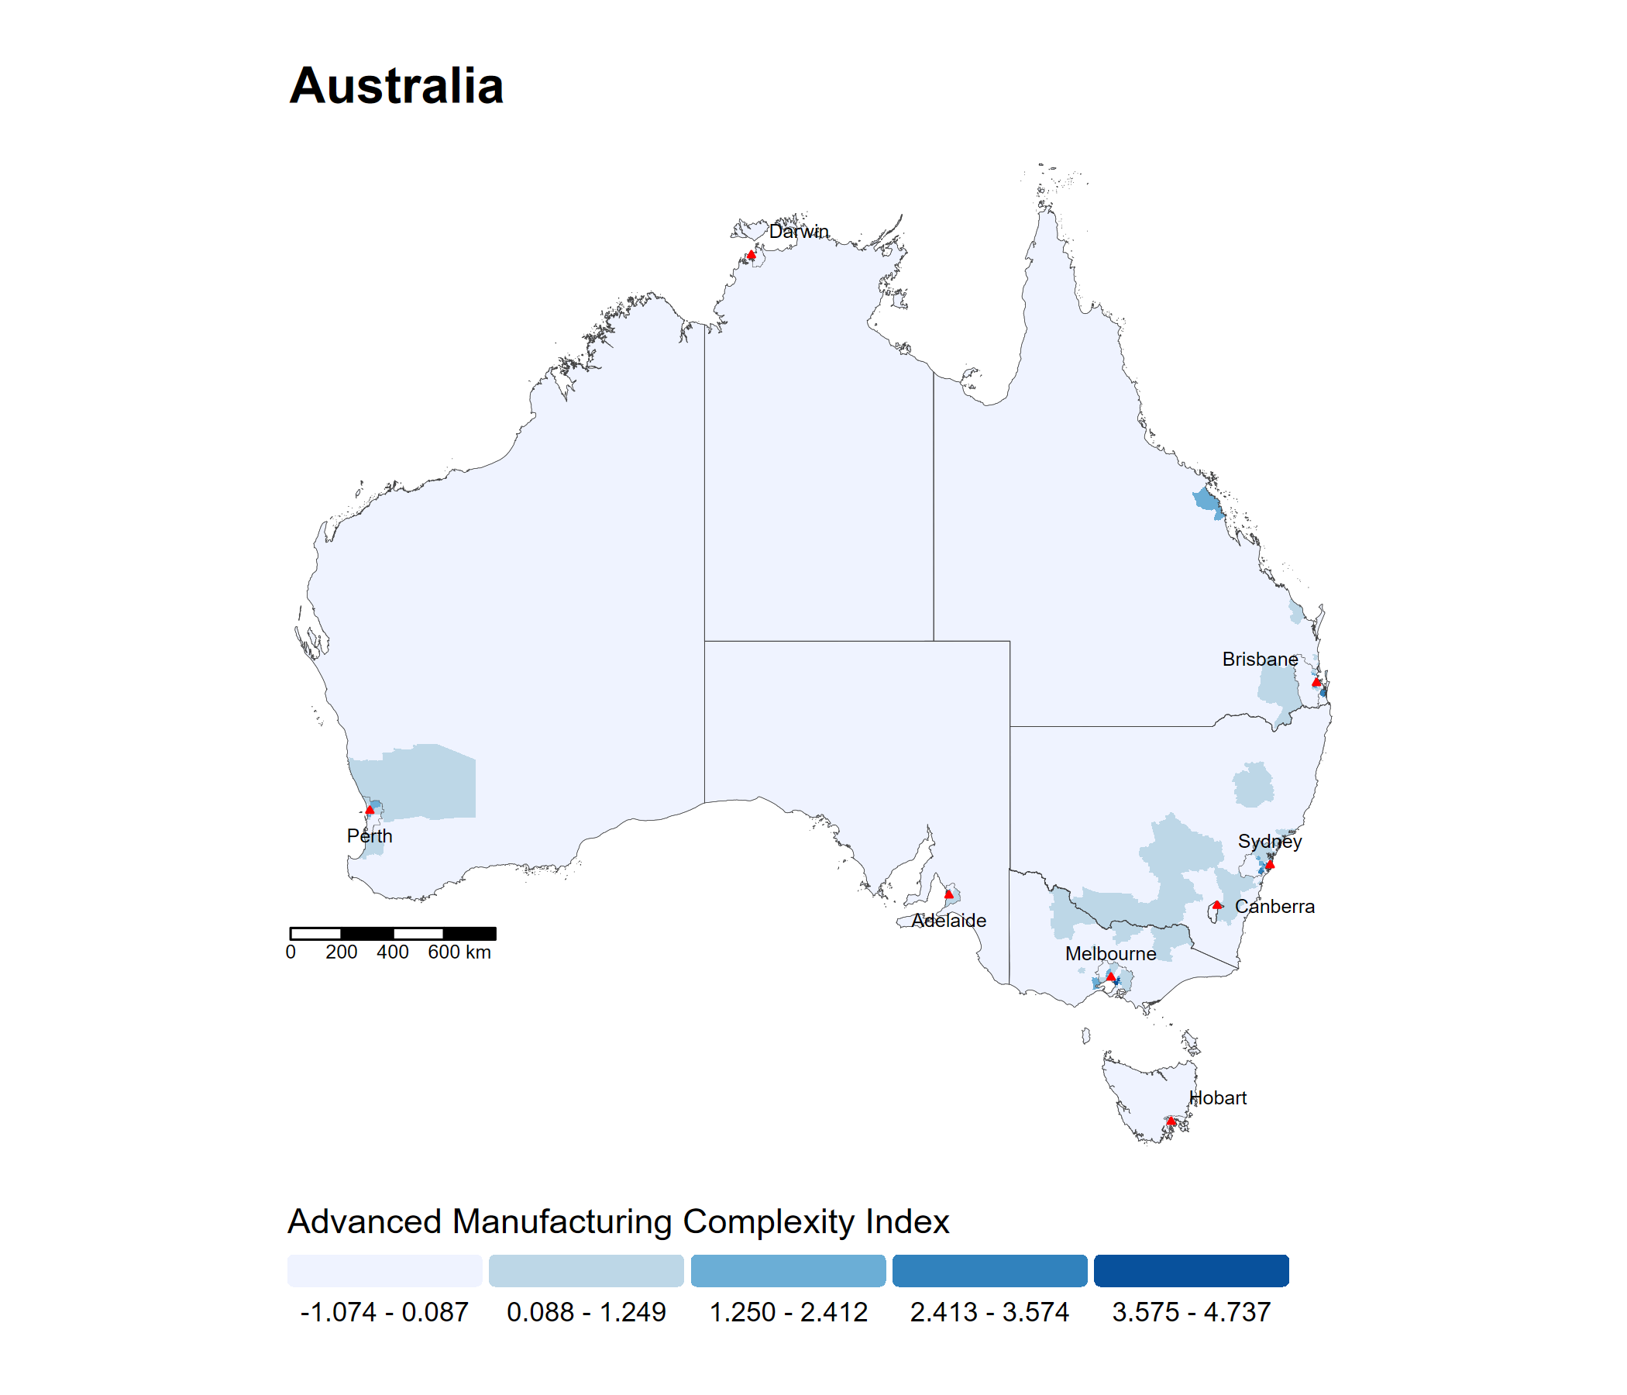
Advanced manufacturing in Australia

Slide 8
Data and methods (1)
Data for the independent and control variables are drawn for the year 2021.
  Data include 2021 Census data on employment, patents, average age, mortgage payments and workforce participation. In addition, additional regional data was drawn from diverse sources such as the gross regional product, university campus locations, locations of Australian critical minerals, and information about ports, schools and hospitals

Slide 9
Data and methods (2)
Number of business entry in a SA3 region is the dependent variable indicating a region’s overall capacity to attract businesses and factors of productions to the region, which is defined as regional competitiveness (Huggins, 2003; Huggins et al., 2013; Potter, 2009).
Economic complexity for the advanced manufacturing sector is the independent variable.
  We calculated economic complexity indicators of the advanced manufacturing sector for Australian Statistical Areas Level 3 (SA3) regions using employment data from the 2021 Census.
  Advanced manufacturing sector was defined based on the Australian Bureau of Statistics (ABS) definition and industry classification
  Using the method of weighted correlations of employment shares (Davies & Maré, 2021), we calculated economic complexity for advanced manufacturing of Australian SA3-level regions.

Slide 10
Data and methods (3)
The data was arranged by SA3 regions including X and Y coordinates enabling us to run spatial analyses.
  Out of 359 SA3 regions in Australia, there are 18 non-spatial regions (Migratory – Offshore – Shipping and No Usual Address regions) and one Outside Australia region, which were not included in the data analyses. In addition, four SA3 regions (Illawarra Catchment Reserve, Blue Mountains – South, Cocos (Keeling) Islands and Jervis Bay) were dropped due to lack of business entry data for the year 2023, reducing total number of regions for data analyses to 336.

Slide 11
Data and methods (4)
Every region has one observation in which independent variables are lagged by two years.
  Independent variables are lagged to address any endogeneity and the reality that it takes time for the regional factors to influence the creation or the relocation of businesses, and the factors of production in a region (Ocampo-Corrales et al., 2021).
Spatial econometric models (Spatial Two Stage Least Squares)
  Spatially lagged dependent variable
  Spatially lagged independent variable

Slide 12
Findings
Lagged dependent variable & first order queen contiguity matrix
  Positive and statistically significant (0.01) direct and indirect impact
  Positive and statistically significant (0.01) lag variable effect
Lagged independent variable & first order queen contiguity matrix
  Positive and statistically significant (0.01) direct and indirect impact
  Positive and statistically significant (0.01) lag variable effect

Slide 13
Summary
The growth of advanced manufacturing can enhance regional competitiveness and generate spillover effects.
Findings suggest that government policies reshoring advanced manufacturing are likely to positively improve competitiveness of Australian regions .

Slide 14
Feedback/Comments/Questions

