Slide 1


Possibility, institutions, and the price of equality in agglomeration economies
Anita De Franco, PhD
Polytechnic University of Milan
The Cambridge Journal of Regions,
Economy and Society 2026 Conference
16 - 17 July 2026
McGrath Centre, St Catharine’s College, Cambridge, UK
Chandradas Balan © Unsplash

Slide 2

Contents
Introduction
Theoretical framework
Analytical framework
Some examples
Discussion and concluding remarks
Fernando Andrade © Unsplash

Slide 3
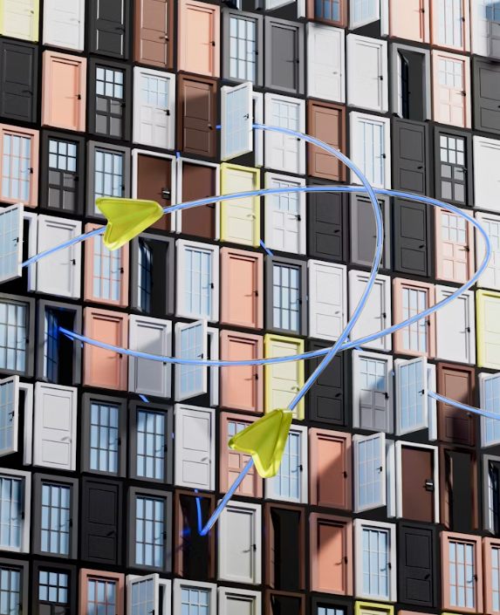
1. Introduction
Main claim:
This contribution argues for a new, foundational concept of possibility to investigate material equality and the trade-offs between individual liberty and well-being.
With a particular focus on complex agglomeration economies such as cities, the enhancement of possibilities will be explored as an ideal principle to be rediscovered in social choice and public policy interventions.
Igor Omilaev © Unsplash

Slide 4

1. Introduction
Ideas to be challenged:
increases in levels of freedom, equality, and prosperity are impossible (i.e. mutually exclusive);
development is possible/admissible only under determined circumstances;
differences in urban performance lie in
(rather vague) place-based factors.
Lacyec © Unsplashc

Slide 5
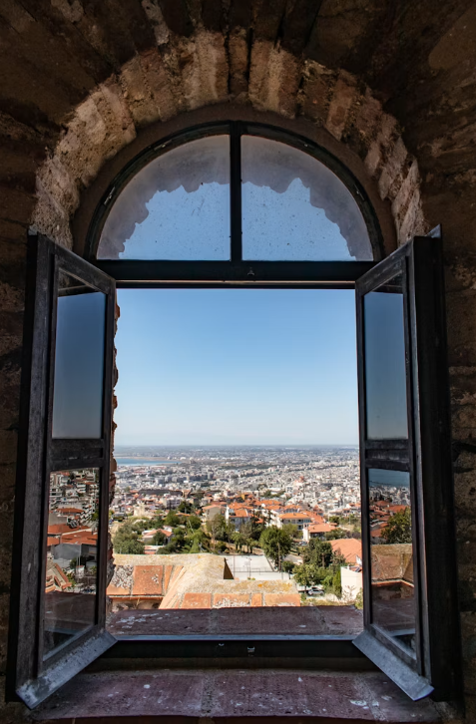
1. Introduction
Main hypothesis:
The value of agglomeration lies not only in increasing the probability of achieving known goals, but in expanding the range of unknown goals that individuals can discover and pursue.
- Cities as “powerhouses of possibilities”?
Diana Deaver © Unsplash

Slide 6
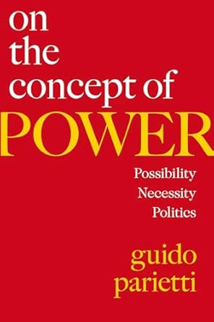

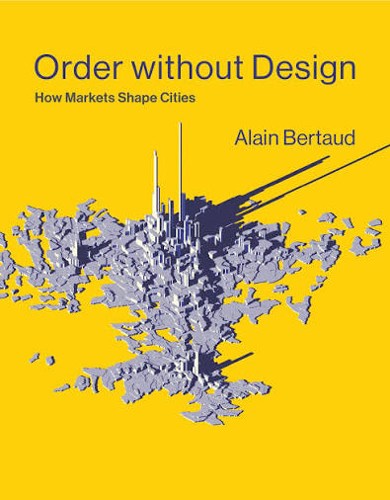
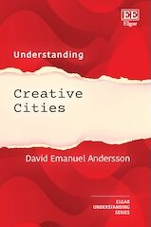
1. Introduction
Emerging claims/needs from the debate; the necessity to:
restore the search for robust meta-principles guiding policy interventions;
challenge binary and static approaches in conceiving (re)distributive policies;
better frame equity issues in agglomeration economies, with more specific attention on urban regulation.

Slide 7

2. Theoretical background
The notion of «possibility» and agglomeration economies
Brian Ceccato © Unsplashc

Slide 8
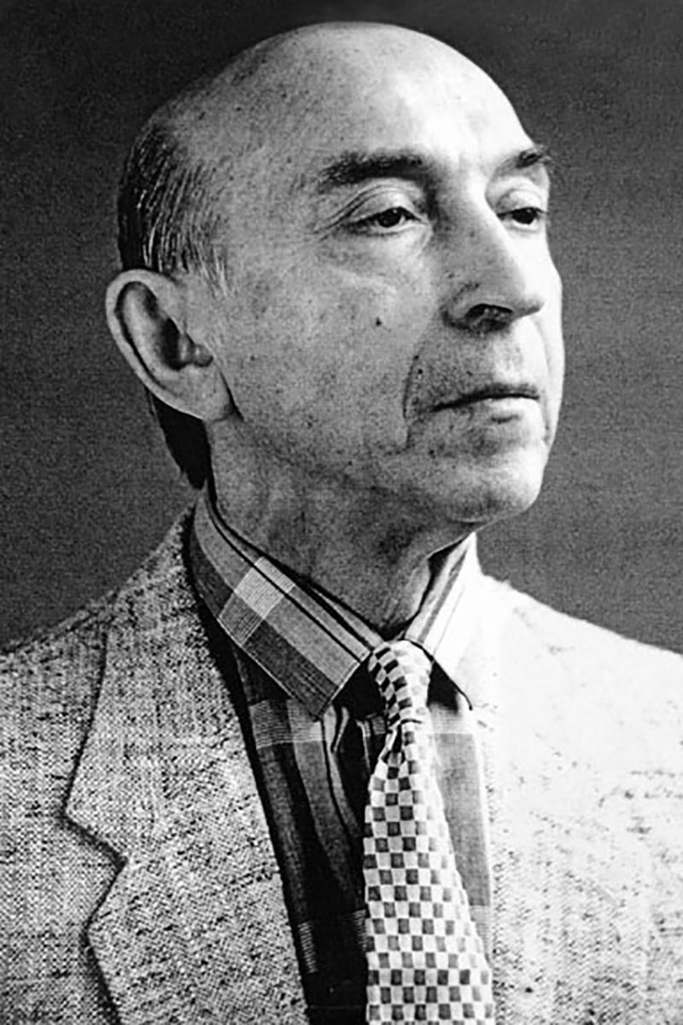
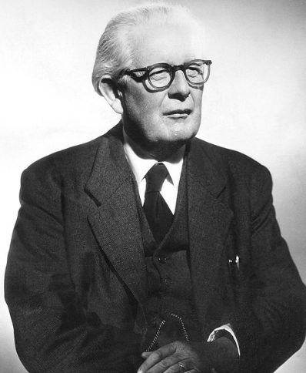
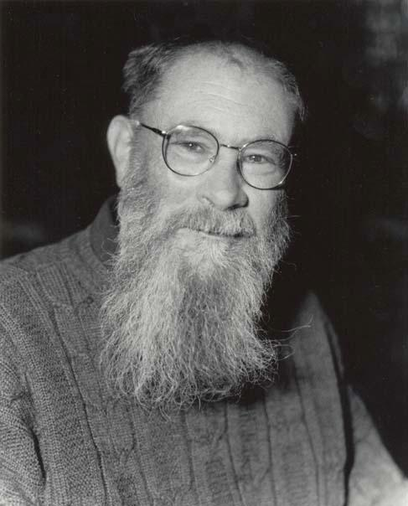
2. Theoretical background
Lofti Zadeh
fuzzy logics / uncertainty
Jean Piaget
combinatorial reasoning in human development
David Lewis
speculative thinking and «worlding» practices

Slide 9
2. Theoretical background
The world is not perfectly predictable.
Possibility is a non-probabilistic modal operator (Zadeh, 1978), driven not by the likelihood of events, but their “availability”.
2. Human possibilities are a superset.
Comprising “brute” possibilities – connected to our physical/biological nature, and high-ranking “social possibilities” (connected to non-instinctual dimensions of deliberate choice and creative agency.
Π(H) = Πb​(H) ∪ Π c​(H)
3. Possibility distributions are “non-exclusive”.
Unlike probability distributions, possibilities comply with a criterion of “non-compensation” (Zadeh, 1978) and “non-interaction” (Lewis, 1989).
Lofti Zadeh
fuzzy logics

Slide 10
2. Theoretical background
The world is not perfectly predictable.
Possibility is a non-probabilistic modal operator (Zadeh, 1978), driven not by the likelihood of events, but their “availability”. P = (0, 1)
2. Human possibilities are a superset.
Connected to our physical/biological nature, but boosted by our individual/social nature e.g. deliberate choice, complex planning, creative agency.
3. Possibility distributions are “non-exclusive”.
Unlike probability distributions, possibilities comply with a criterion of “non-compensation” (Zadeh, 1978) and “non-interaction” (Lewis, 1989).
Jean Piaget
combinatorial reasoning

Slide 11
2. Theoretical background
The world is not perfectly predictable.
Possibility is a non-probabilistic modal operator (Zadeh, 1978), driven not by the likelihood of events, but their “availability”. P = (0, 1)
2. Human possibilities are a superset.
Comprising “brute” possibilities – connected to our physical/biological nature, and high-ranking “social possibilities” (connected to non-instinctual dimensions of deliberate choice and creative agency.
3. Possibility distributions are “non-exclusive”.
Unlike probability distributions, possibilities comply with a criterion of “non-compensation” and “non-causality” (Lewis, 1989): increases in one value does not imply decreases in other values.
David Lewis
«possible worlds»

Slide 12

2. Theoretical background
Recently, possibility studies are shifting attention from "cultures of learned helplessness" to perspectives that emphasize the power of individual and social agency, creativity, and interactions (Fratesi et al., 2024: 364;
Huggins & Thomson, 2025).
Behavioural theories
Possibility
studies
Spatial
analysis
Felix Ngo © Unsplash

Slide 13
2. Theoretical background
Within this perspective(s), regional economics, human geography, and urban planning can make a distinctive contribution by showing the structure within which possibilities take place; especially on:
  the role of institutions, and relative performance,
  in setting possibilities, and
  the role of interactions, in space and time,
  in combining possibilities for social systems.
Behavioural theories
Possibility
studies
Spatial
analysis
Felix Ngo © Unsplash

Slide 14

3. Analytical framework
Let us conceptualise socio-economic agents
not as utility function maximizers,
but as explorers and exploiters of possibilities.
Imkara Visual © Unsplash

Slide 15

3. Analytical framework
The possibility space of individual agents can be represented as
P_{x}(t)= f (I_{x}(t), E_{x}(t))
where:
· P_{x}(t) = the possibility space of individual x at time t;
· I_{x}(t) = the internal state of individual x at time t; it denotes the individual’s internal state, including knowledge, skills, talents, cognitive capacities, and motivations
· E_{x}(t) = the external environment relevant to individual x at time t; it denotes the external environment, including physical, social, technological, and institutional conditions for action.
Logan Voss © Unsplash

Slide 16


3. Analytical framework
P_{x}(t)= f (I_{x}(t), E_{x}(t))
The interesting point is that f need not be additive or linear.
It expresses that possibilities emerge from the interaction between the person and the environment.
Introducing the time variable t makes explicit that possibility spaces are dynamic rather than static.
Both individuals and their environments change over time, allowing us to account for processes such as learning, ageing, institutional reforms, and socio-technical innovations.

Slide 17
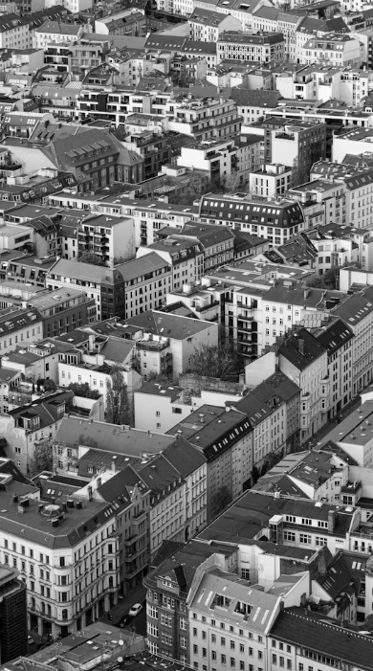
3. Analytical framework
Note that:
Standard policy making is dominated by allocative models
Creating “opportunities” (instead of enhancing “possibilities”), means to arbitrarily select and work only a minimal part of the “world of the possible”.
Possibility-based models conceive policies strickly as means
To sustain over time agents’ possibilities: how they flow, expand, combine or contract.
gabrielK © Unsplash

Slide 18
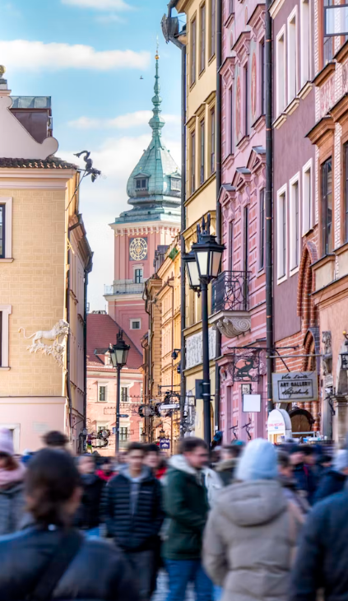
3. Analytical framework
Density matters because it increases exposure to pluralism and diversity: by bringing together heterogeneous people, activities, and resources, agglomerations create a wider field of potential interactions from which new and unforeseen possibilities may emerge.
Jakub Żerdzicki © Unsplash

Slide 19

4. Some examples
Ilia © Unsplash

Slide 20

4. Some examples
Example 1: Entrepreneurial Milieus
Two identical cities experience the same innovation trigger, but productivity rises only in City A, not in City B.
Traditional approaches stress the relevance of density, proximity (+ probability of exchanges);
Possibility-based views explain the difference through institutional conditions
(+ capacity to sustain exchanges over time).
Ilia © Unsplash

Slide 21
4. Some examples
Example 2: Creative districts.
Consider an old industrial district. For years, little changes. Then social compositions change, and growth suddenly accelerates.
Traditional accounts: gains from continuous interactions (density/proximity/of existing resources).
But why not before?
Possibility-based accounts: gradual reshape of possibility space (creation/combination of latent resources).
Ilia © Unsplash
Notes:
(livello micro) performance istituzionale nel sostenere e attualizzare possibilità latenti è il punto «place-based» che realmente ci interessa

Slide 22

4. Some examples
At some point, the system crossed a threshold.
The possibility space became so rich that a single interaction could actualize many possibilities simultaneously.
The delta increased dramatically:
Δ Interaction (t) = I(t) × S (P(t))
Where:
I(t) = intensity of interactions;
P(t) = historically accumulated possibility space;
S (P(t)) = the systems’ capacity to actualise possibilities.
USGS © Unsplashc

Slide 23

4. Some examples
Possibility Indexes (PI) could be developed to measure the institutionally mediated availability of future possibilities (not of present resources, as the Gini Index does).
Where:
PI=0: institutions almost completely prevent the actualization of possibilities;
PI=1: institutions fully enable their actualization.
Note that land-use plans, building codes, and zoning, really differ from one place to another.
Kasem Sleem © Unsplash

Slide 24
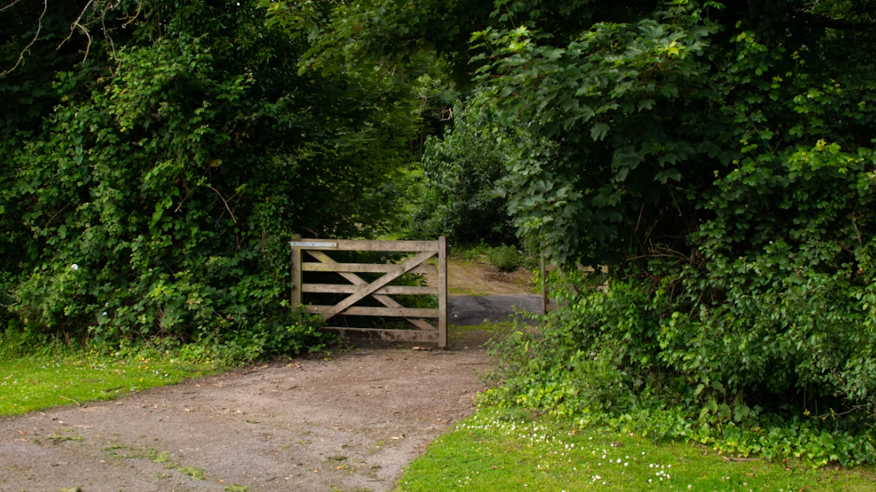
5.
Discussion and concluding remarks
Bernardine Cantwell © Unsplash

Slide 25
5. Discussion and concluding remarks
What about possibility and equality?
People move in space to pursue different ends,
not the same goals.
Equality is also about sustaining agents’ search for possibilities, not only redistributing resources.
Institutional quality is the place-based dimension that deserves the greatest attention.
Felix Ngo © Unsplash

Slide 26
5. Discussion and concluding remarks
What (is not)
≠ probability (non-parameterizable)
≠ opportunity (non-utilitarian)
≠ practicability (not strictly pragmatic)
Where (to go)
≠ sets/trees/options
= fields/streams
Who (benefits)
= individual freedoms (non-paternalistic)
= collective interest (non-libertarian)
How (to)
…with different kinds of spatial plans (if any)
Logan Voss © Unsplash

Slide 27
5. Discussion and concluding remarks
Policy implications:
While interventions are commonly justified as means to reduce or eliminate so-called market failures,
Possibility-based interventions would instead be means to increase and diversify options in social-economic processes.
Practical implications
In sustainability and the energy transition debates, expanding possibilities may provide a more fruitful guiding principle than optimizing the use of given resources.
Logan Voss © Unsplash

Slide 28
5. Discussion and concluding remarks
Theoretical implications:
Possibility-based theoretical frameworks resonate with perspectives used to challenge the concept of the Pareto optimum (Cordato, 1980).
Unify certain critiques on allocative efficiency and its process-oriented alternatives: e.g. adaptive efficiency (North,1990), catallactic efficiency (Leibenstein, 1966, 1978), X-efficiency (Kirzner, 2000), and De Soto (2009).
Normative implications:
Possibility-based indicators may directly question institutional performances (e.g. municipalities with rigid zoning and limited adaptive capacities would score low).
Logan Voss © Unsplash

Slide 29

Thank you for your attention
anita.defranco@polimi.it
Find me on LinkedIn | ResearchGate | Google Scholar | Scopus
Chandradas Balan © Unsplash

