Slide 1
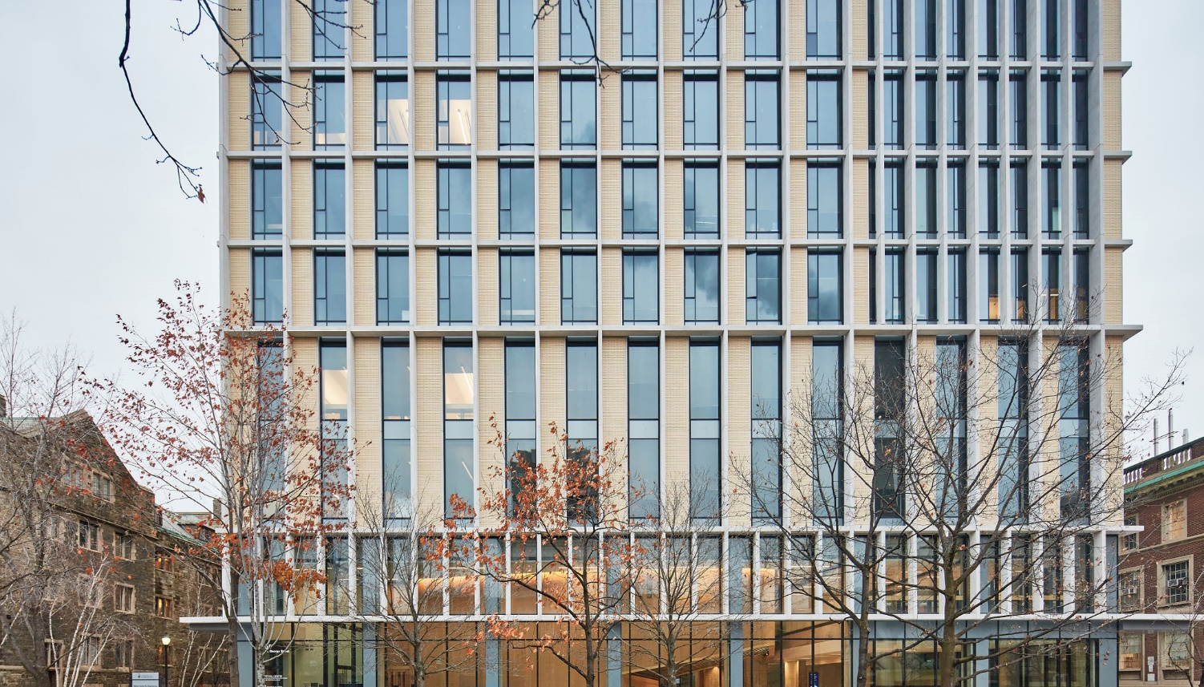

The Rise of the Northern Gunbelt:
Mapping Canada’s Turn to Defence
Tara Vinodrai, Karen Chapple, Sarah Gibbons, Yihoi Jung, Andrew Feng, and Clara Turner

Slide 2
Introduction
Canada
  Shift from post-WW II ”helpful fixer” and international peacekeeper to 2000s collective defence and deterrence
  Carney-Trump era: meet NATO obligation of 2% of GDP, 5% of GDP by 2035
Our approach: Theorizing from the map

Slide 3
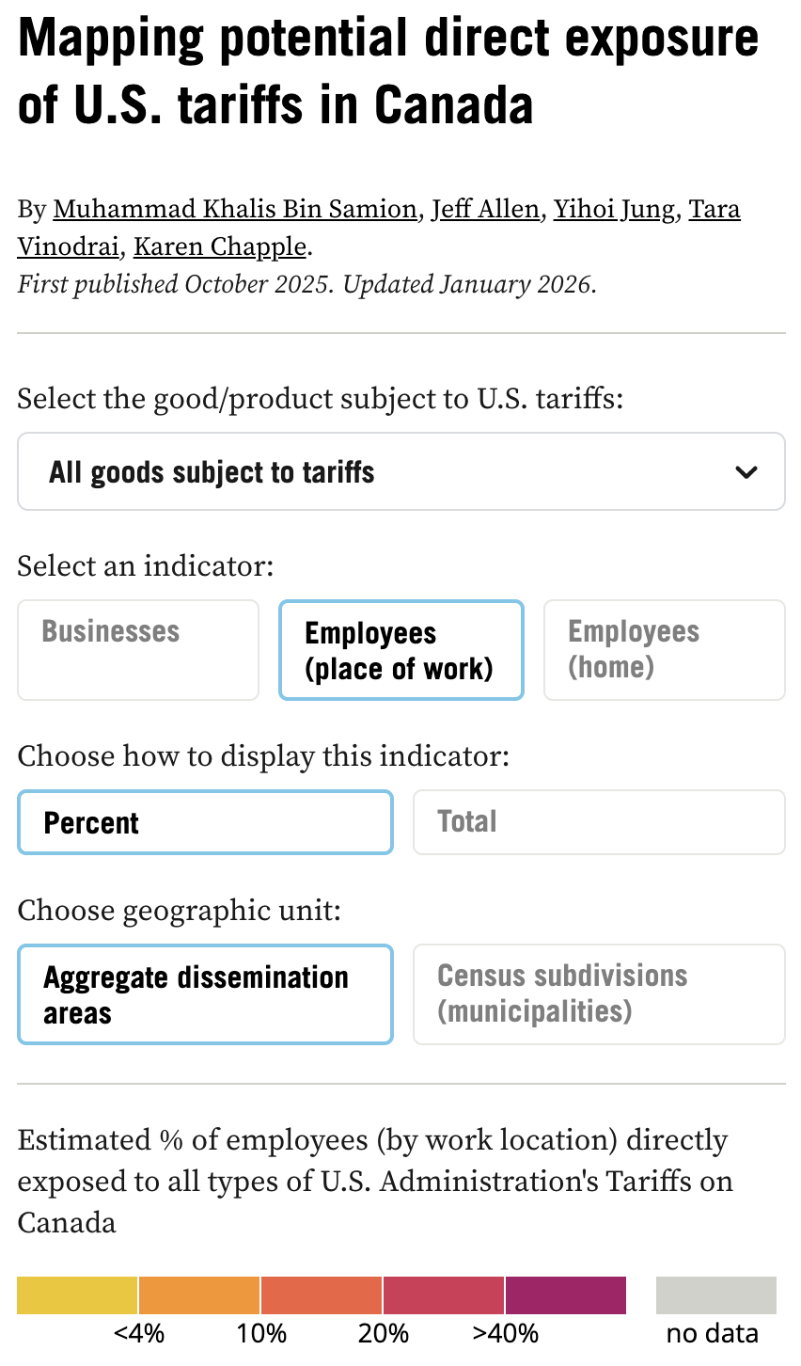
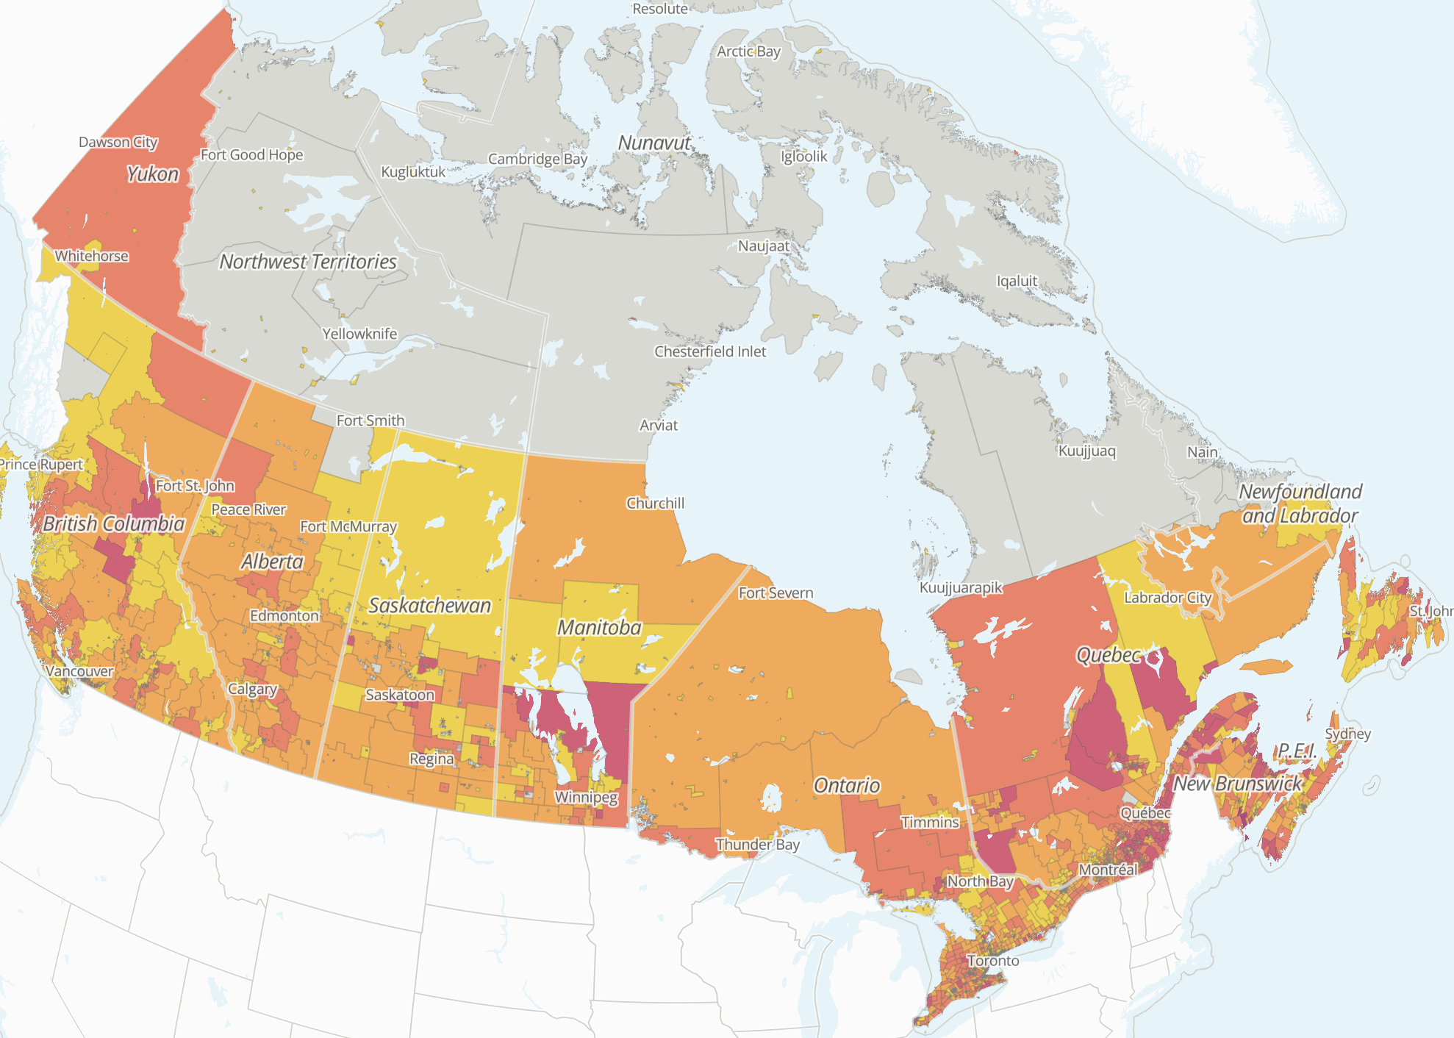
https://mappingtariffs.org/map

Slide 4
Research questions
What is the current geography of defence spending in Canada? (industry and bases)
How might Canada’s new turn to defence impact the geography of defence across the country?
How can Canada best leverage defence spending for regional economic development?

Slide 5
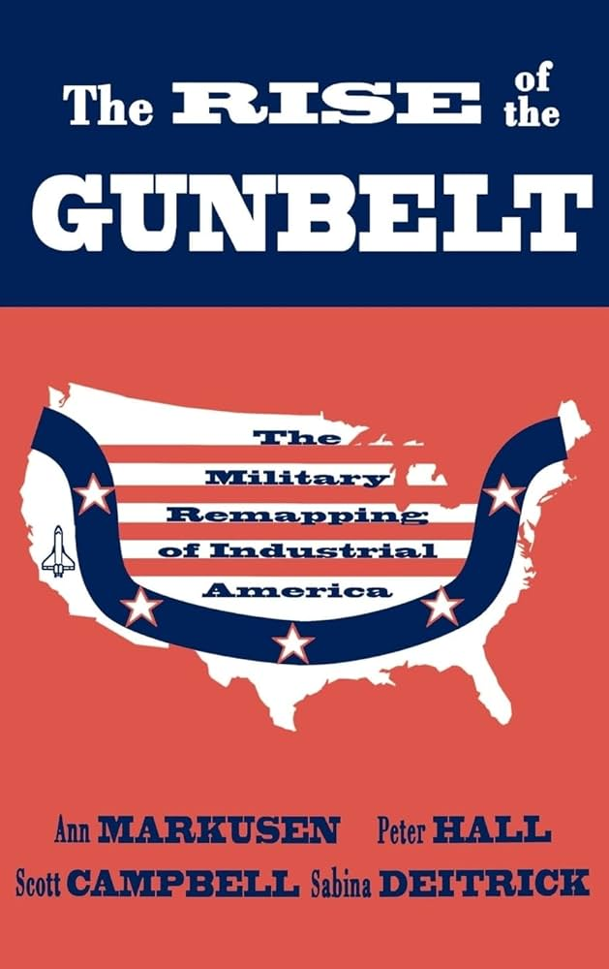
Locating Defence: Theories and Evidence
Theorizing from the South – Rise of the Gunbelt
  Why the Gunbelt?
  Stages of regional development
  Models of the military-industrial city
    The Seedbed Transformed
    The Upstart Military-Industrial City
    The Booster-Incubated Military Industrial Complex
    The Military-Educational Complex
    The Installation-Based Military Industrial Complex
    The Defense-Services Complex
  Impacts:
    Seedbeds of innovation
    Overspecialization and vulnerability
    “In this fashion, taxpayers have paid for the formation of highly technical labor pools in selected military-oriented cities.”

Slide 6
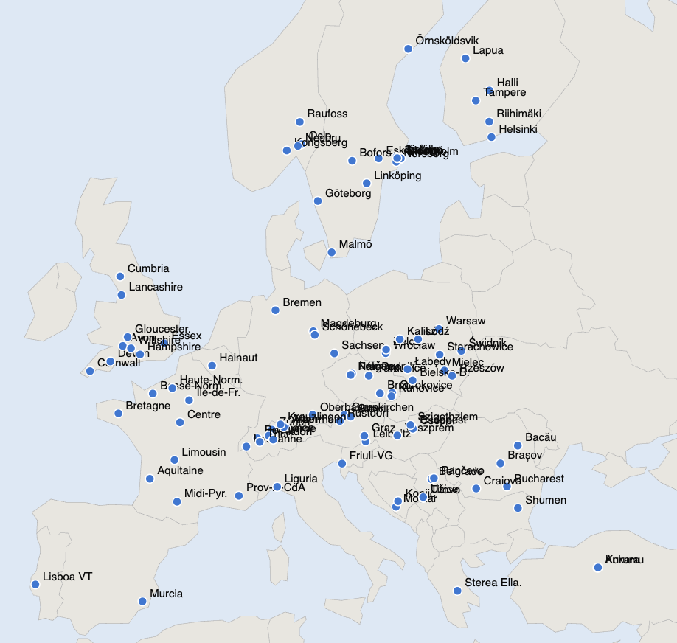
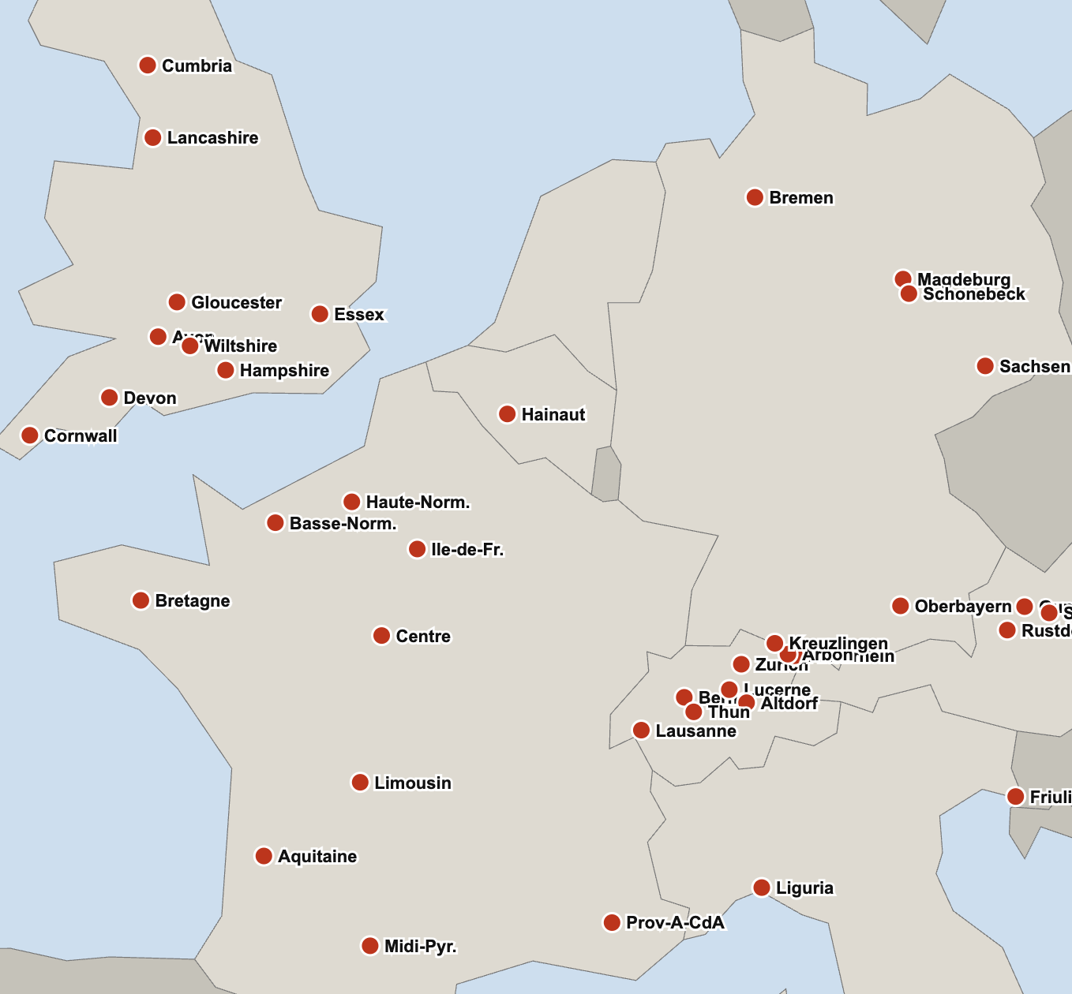
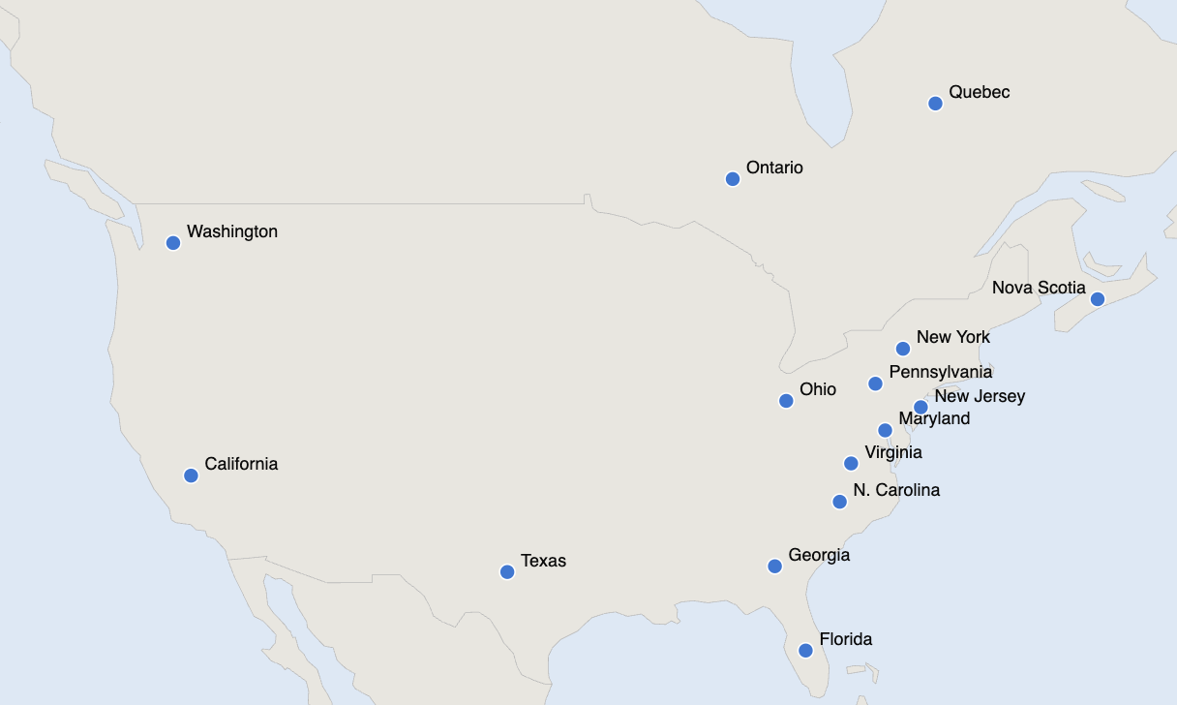
Regional Impact of Defence Expenditure (Braddon, 1995)

Slide 7
Canada’s defence (and industrial) strategy over time
Post-war Industrial Conversion (1945–1957)
Cold War Industrial Expansion (1957–1970)
Industrial Rationalization (1970–1984)
Industrial Benefits and Procurement Policy (1984–2005)
Capability Renewal (2006–2017)
Key Industrial Capabilities (2018–2022)
Industrial Resilience (2022–2025)
Sovereign Capabilities (2025–present)

Slide 8
Data and Methods
Descriptive
  Compiling the NAICS list – core/primary and secondary industries
  Linking to Data Axle firm data, validated via Canadian Defence, Aerospace and Commercial and Civil Marine Sectors Survey
  Augmenting with Department of National Defence contracts data
Analytic -- TBD

Slide 9
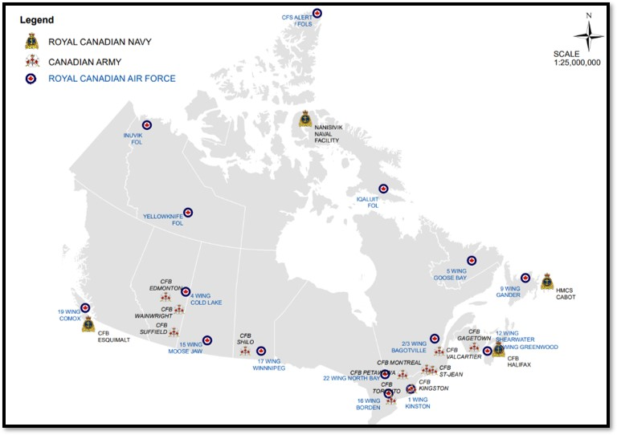
Not (yet) including military bases…

Slide 10
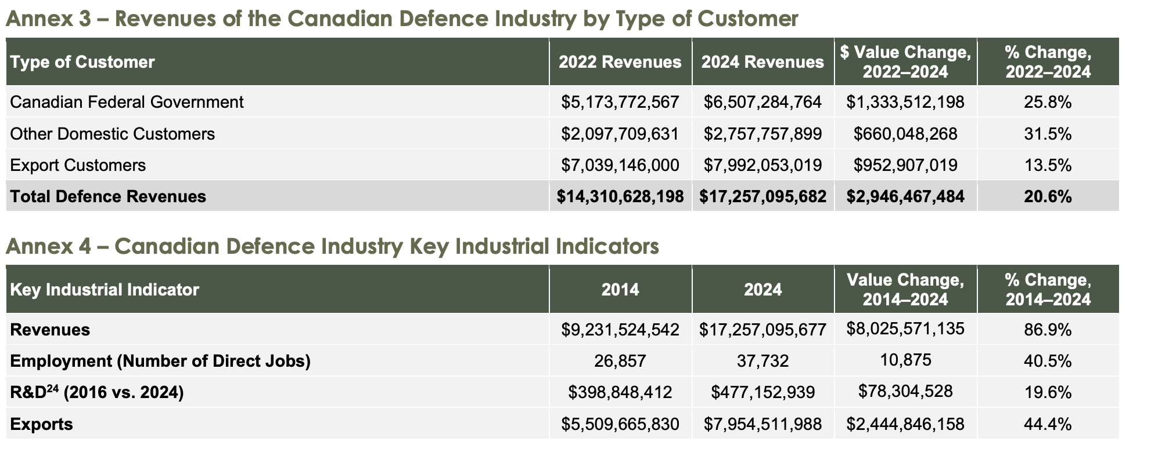

Slide 11
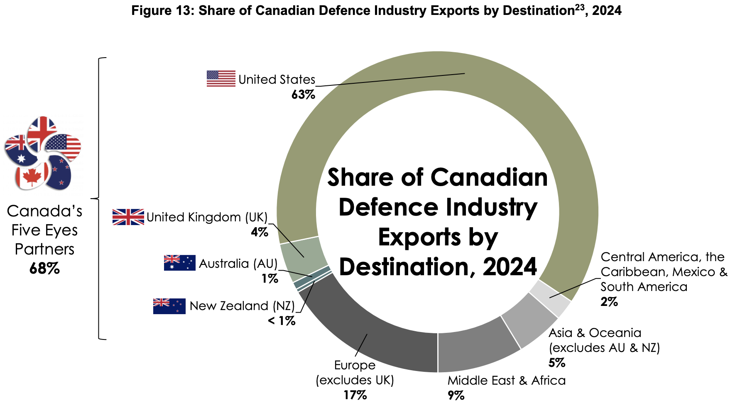

Slide 12
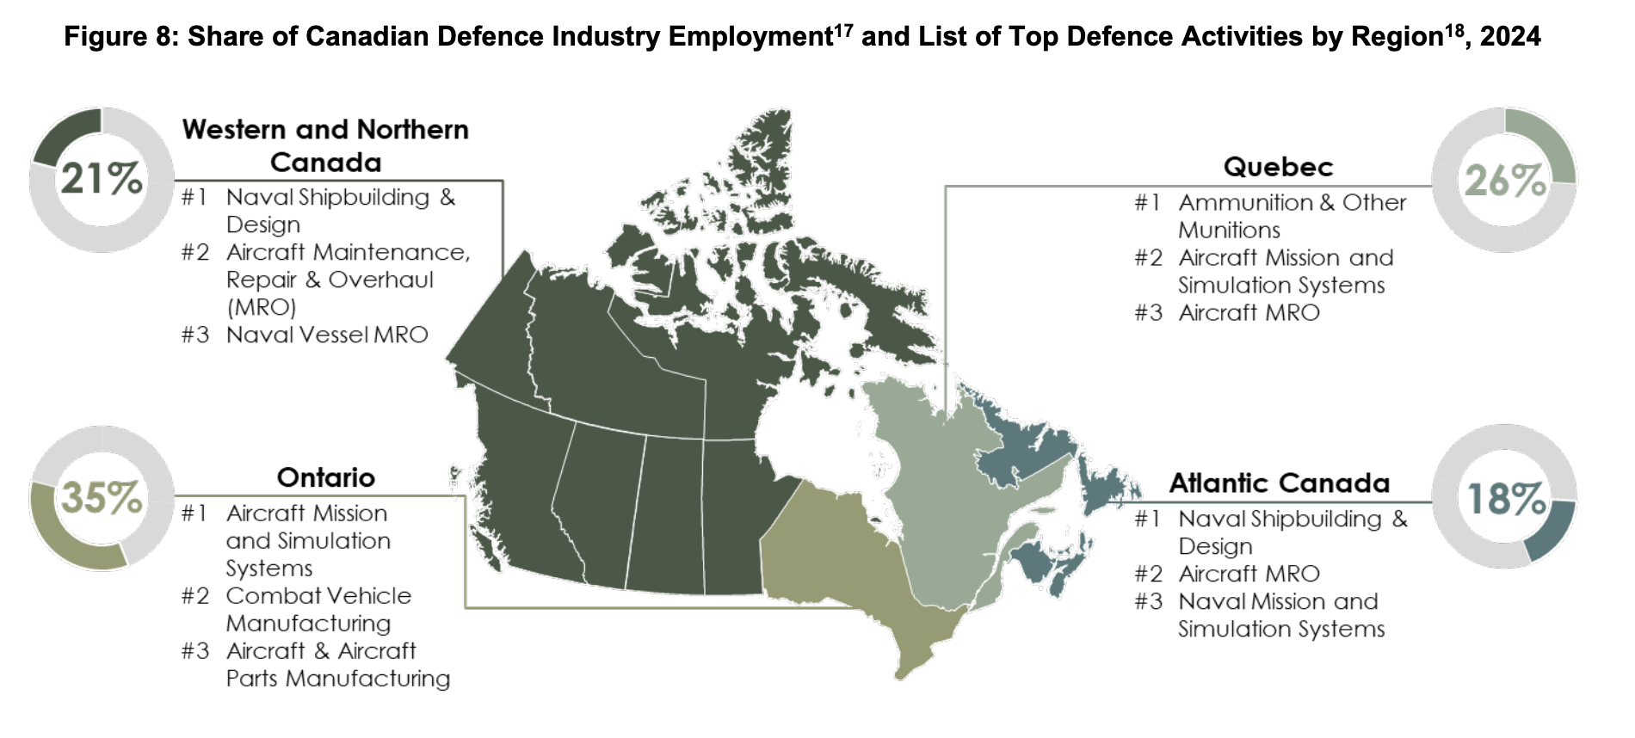

Slide 13
Defence spending increase (~50%):
From CAD $29B in 2010 to $44B in 2026

Slide 14
The Northern Gunbelt? Some initial differences
Role of trade and international partnerships
Canada is not a monopsonist buyer for Canadian industry
Industrial and Technological Benefits rule forces foreign investors to invest in Canada – but where?
Military-industrial city models???

Slide 15
Descriptive findings

Slide 16
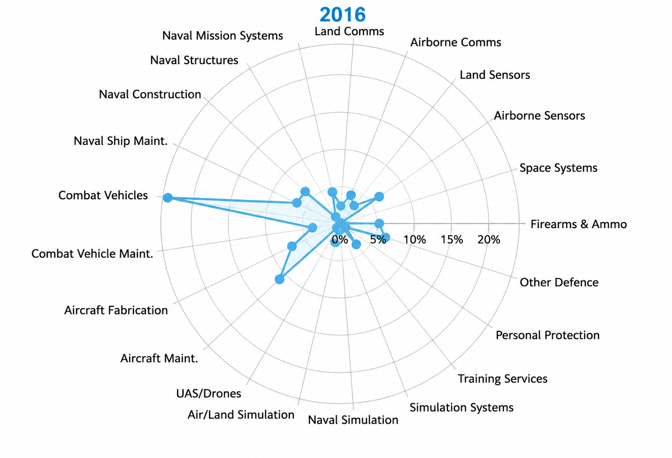
% of sales, 2016
Source: Canadian Defence, Aerospace and Commercial and Civil Marine Sectors Survey

Slide 17
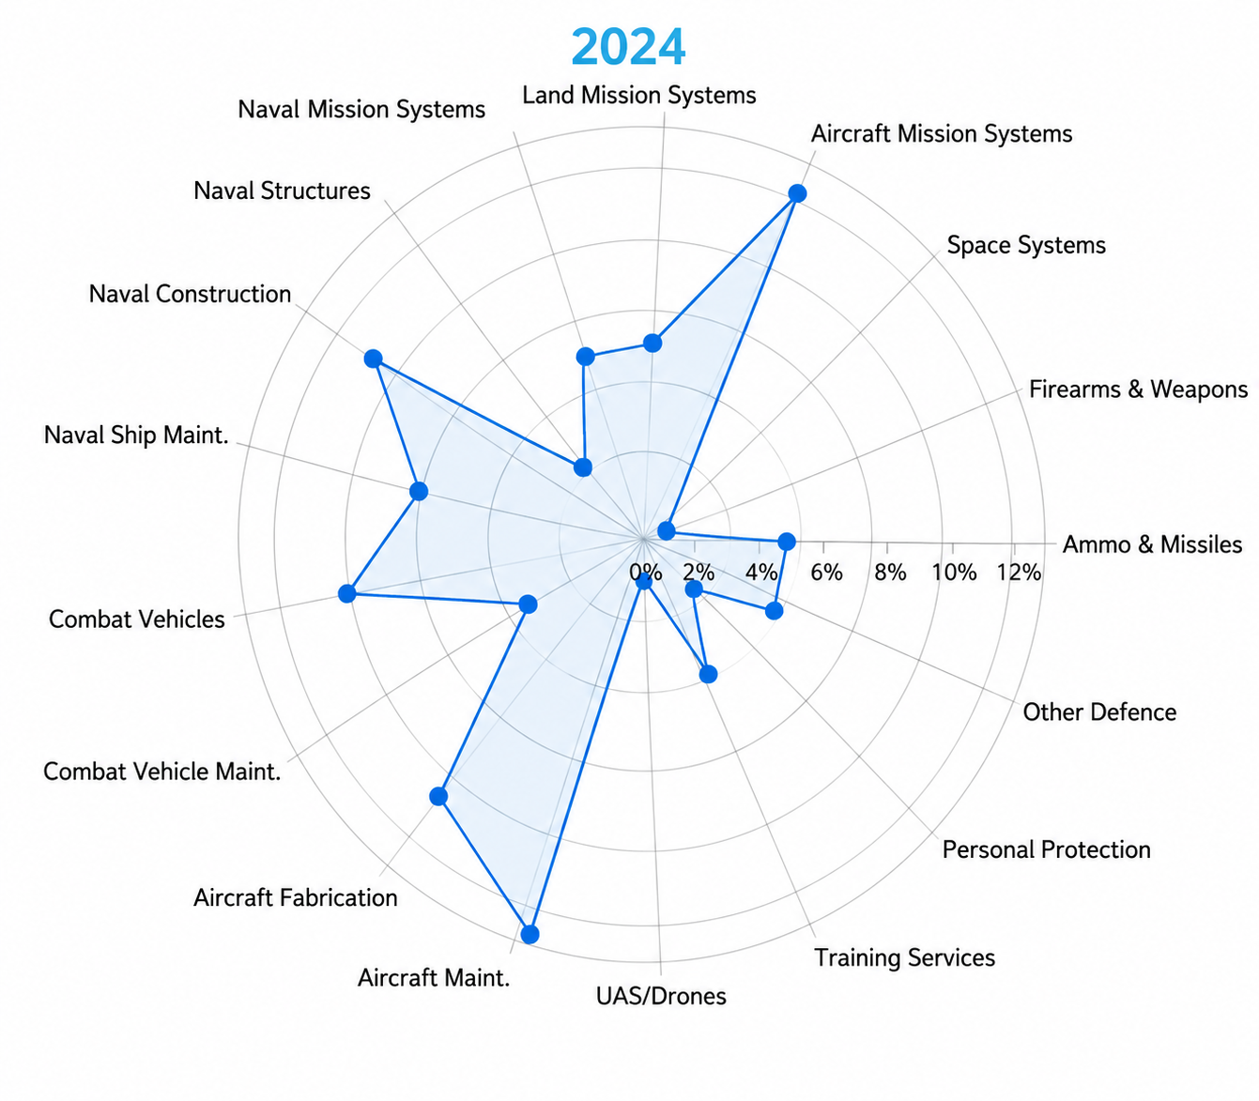
% of sales, 2024
Source: Canadian Defence, Aerospace and Commercial and Civil Marine Sectors Survey

Slide 18
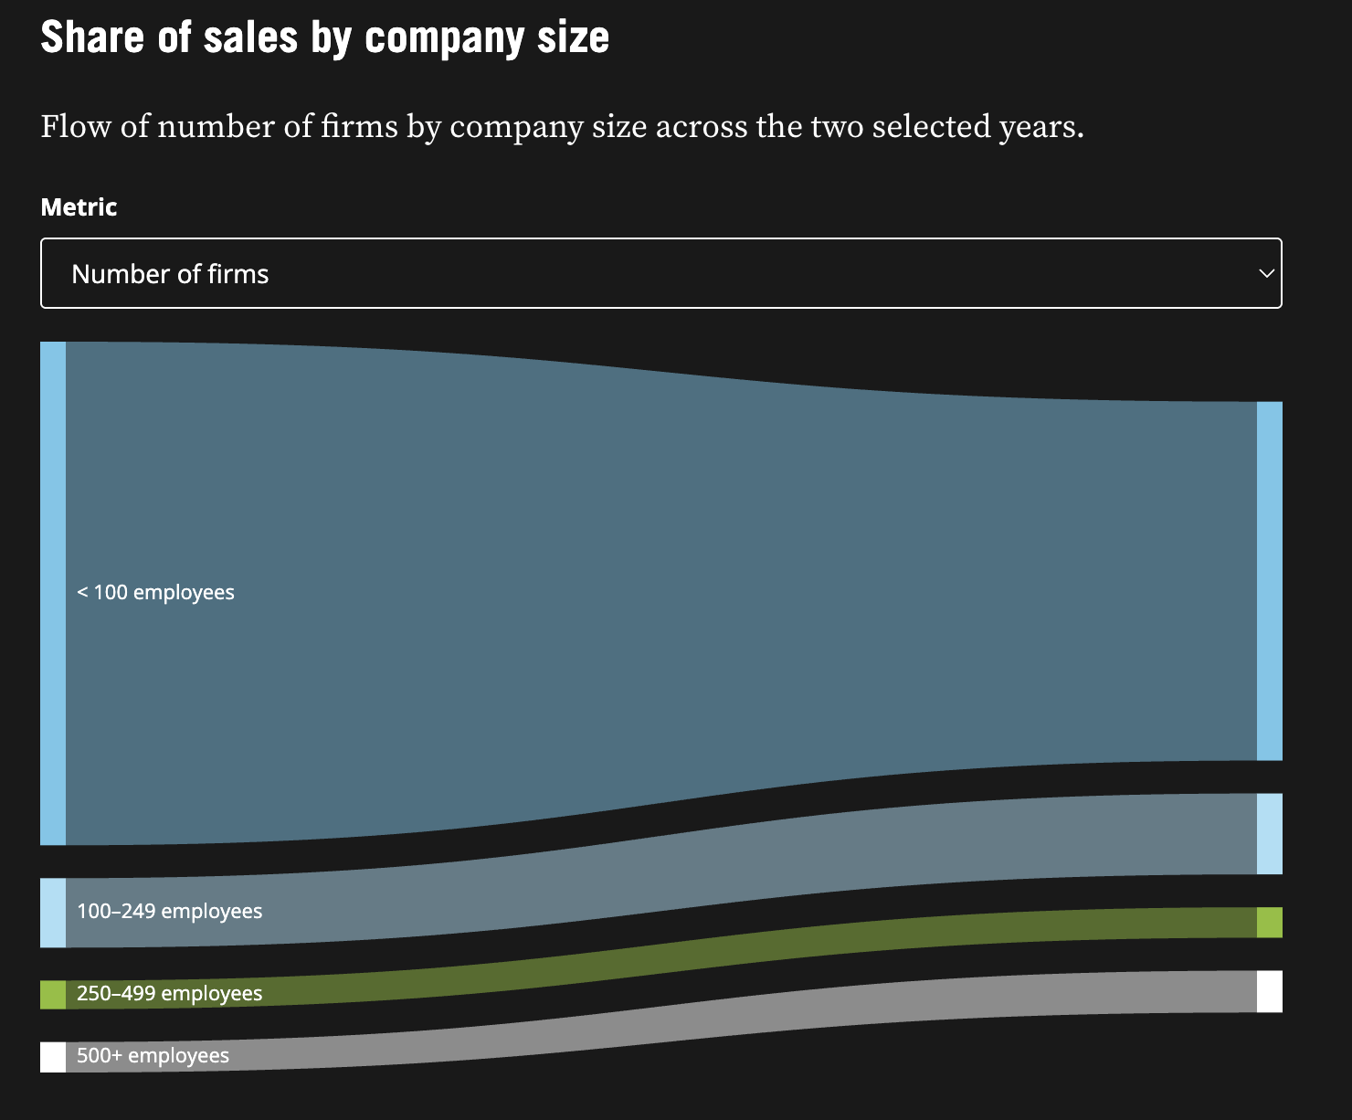
Decrease in small firms, 2016-2024
Source: Canadian Defence, Aerospace and Commercial and Civil Marine Sectors Survey

Slide 19
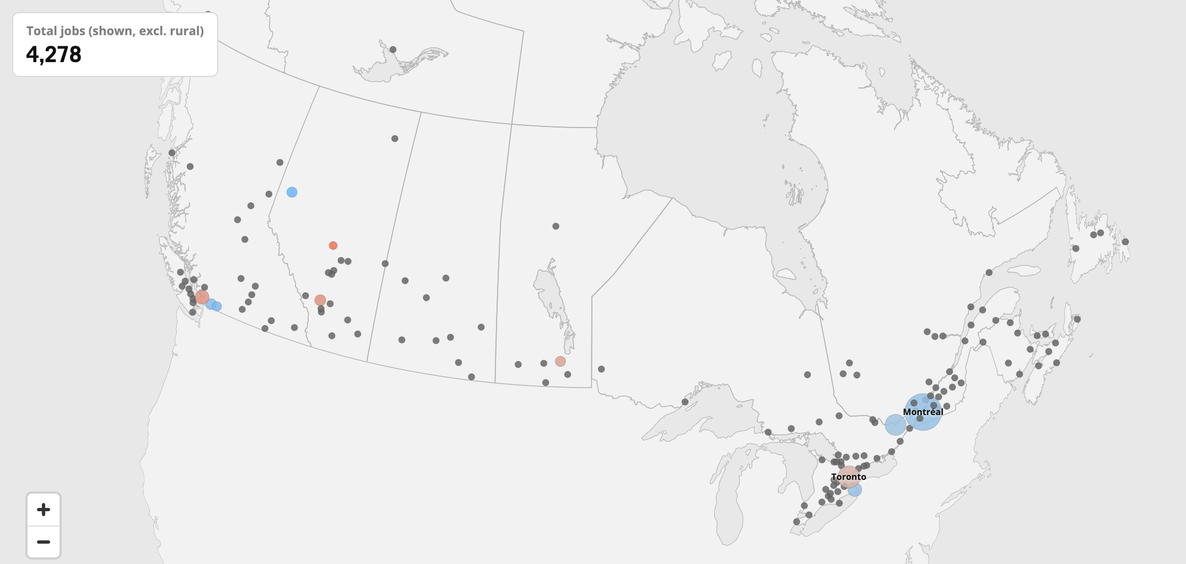
Core defence LQs (employment), 2017

Slide 20
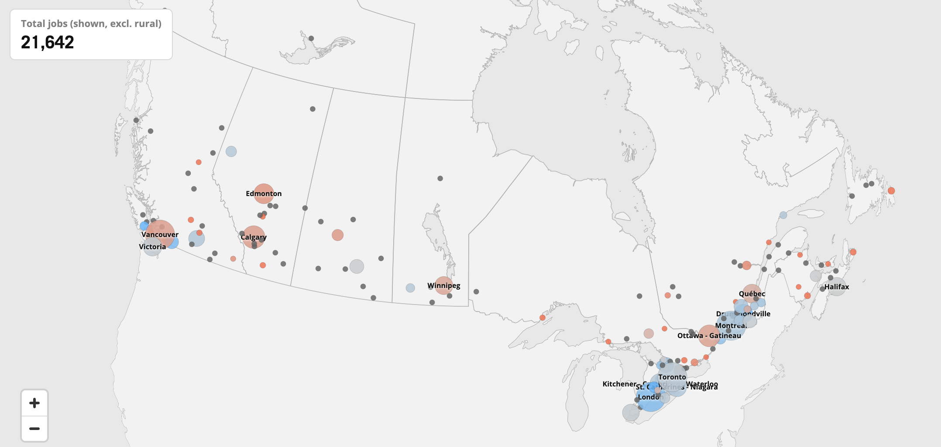
Core defence LQs (employment), 2025

Slide 21
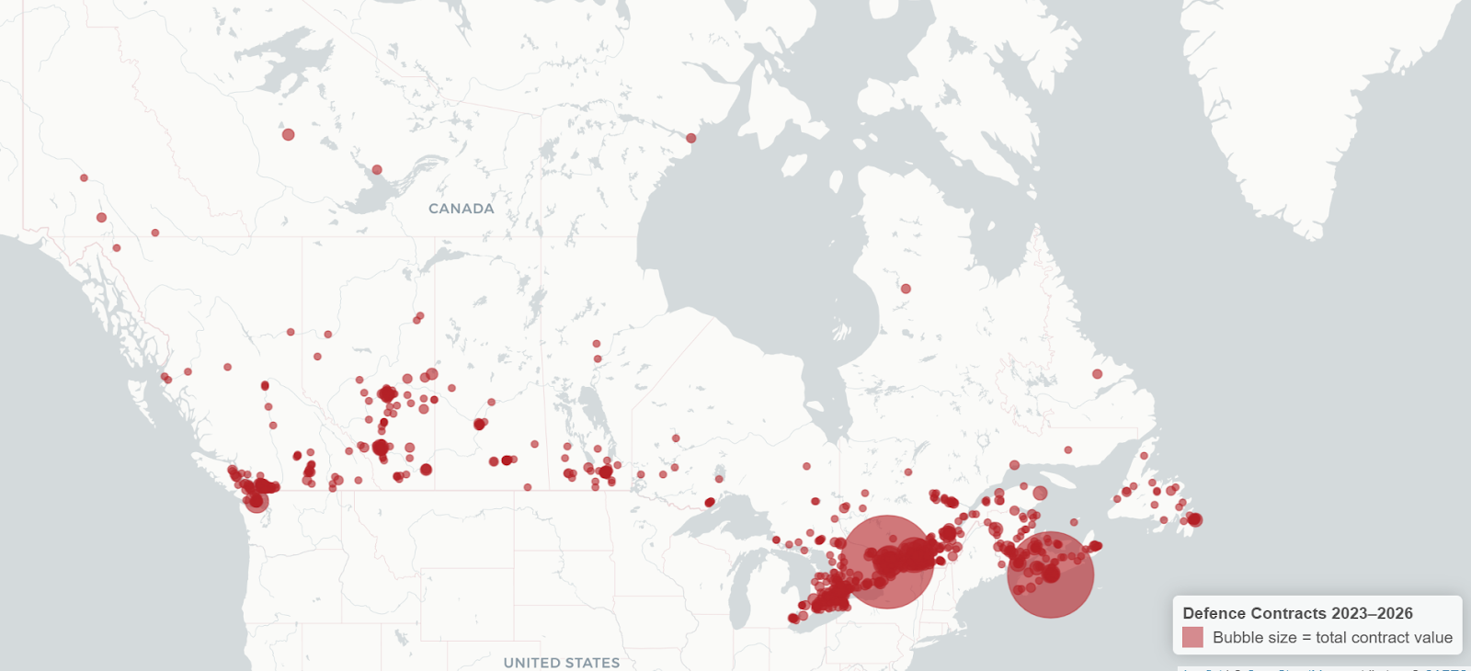
Core defence contracts (by value), 2023-26

Slide 22
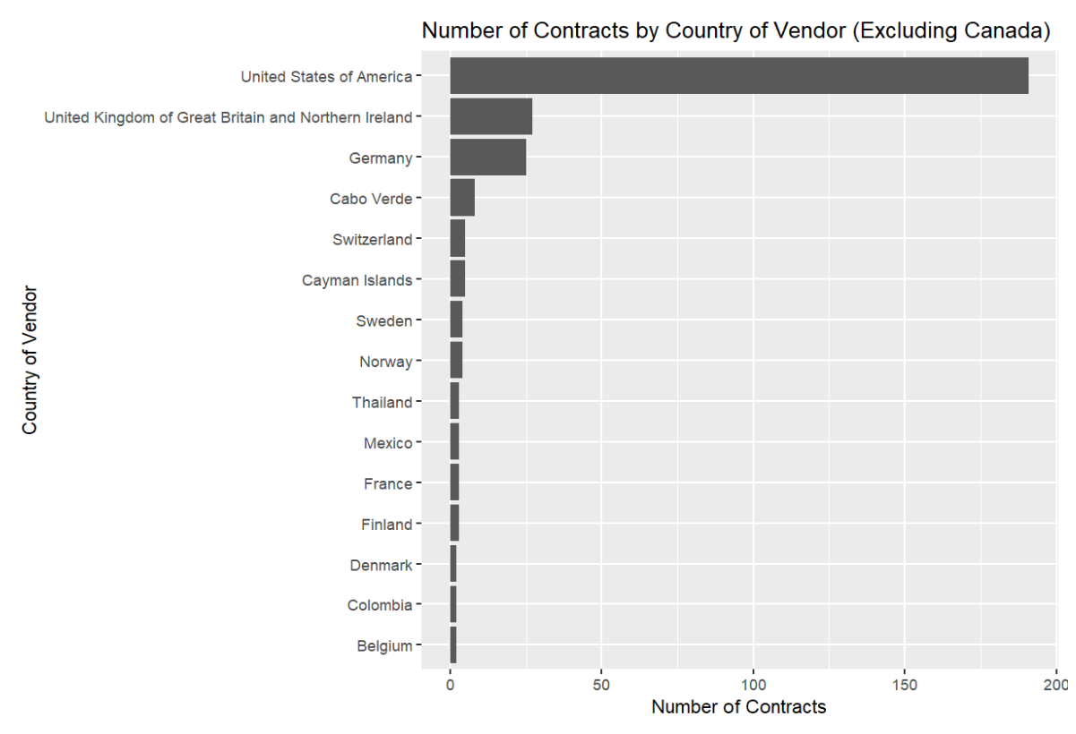

Slide 23
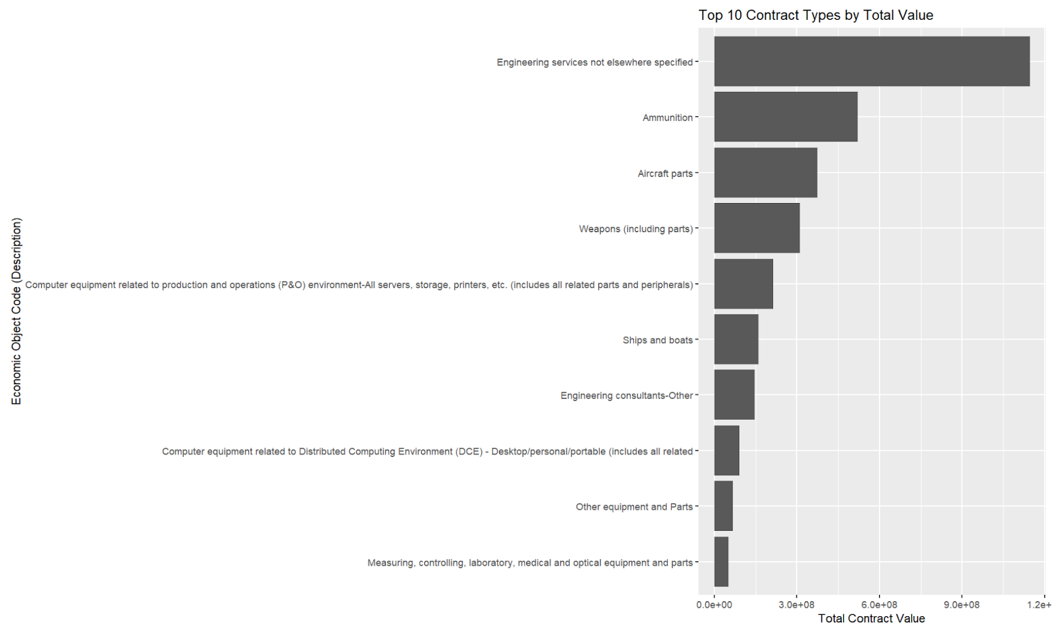

Slide 24
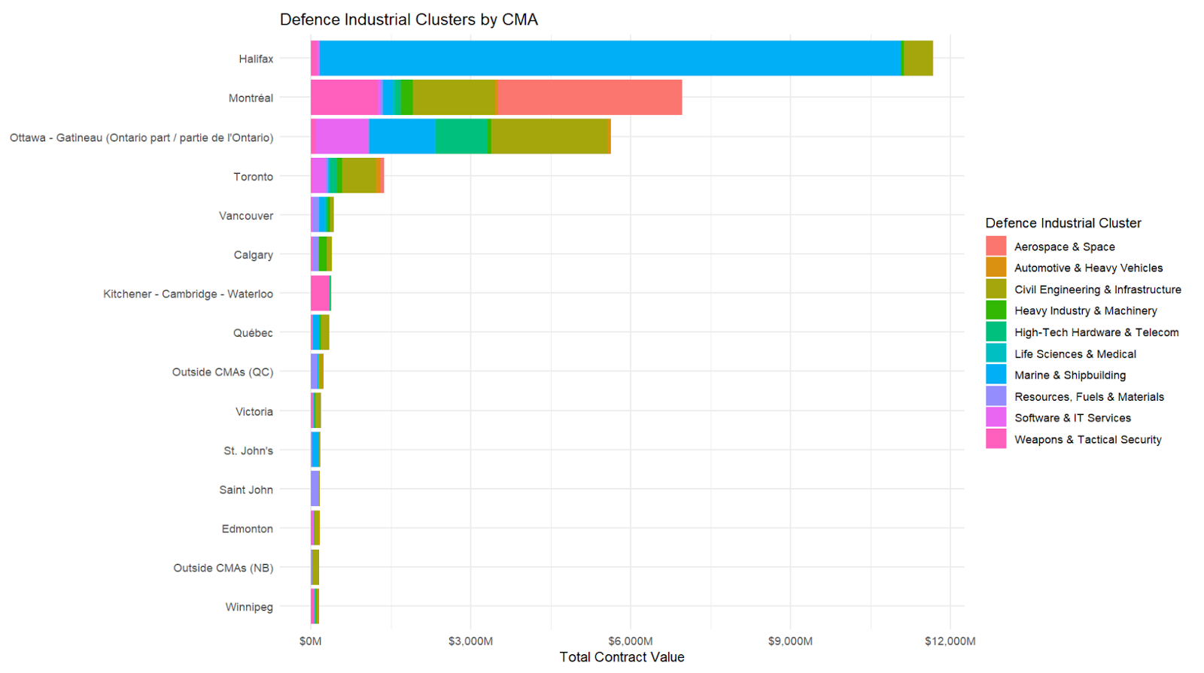

Slide 25
Revisiting the military-industrial city models
The Seedbed Transformed – Greater Toronto Area
The Upstart Military-Industrial City – the Arctic???
The Booster-Incubated Military Industrial Complex – smaller cities
The Military-Educational Complex -- Waterloo
The Installation-Based Military Industrial Complex – Halifax, Dartmouth, Victoria
The Defense-Services Complex - Ottawa

Slide 26
What’s next
For Canada:
  Regional and municipal scramble for defence funding
  Pressure to multi-solve climate and infrastructure issues
For us:
  Finish the paper!

Slide 27

Thank you!

