Slide 1
CJRES 2026 · THEME 2, REVISITING THE ECONOMIC GEOGRAPHIES OF THE DEFENCE INDUSTRY
From Importer to Integrator
Financialised defence capitalism, and the economic geographies of Saudi defence industrialisation
MANAGED DEPENDENCE
Ahmed Alqarout · University of Exeter
St Catharine's College, Cambridge · 17 July 2026
From Importer to Integrator · CJRES 2026, St Catharine's College
1
Notes:
Financialised defence capitalism: Saudi defence industrialisation as one strand of the wider financialisation of the state under Vision 2030. State-led, not liberal; financialisation replacing patronage as the mode of rule; a governance technology that makes the sector legible, auditable and directable. Told through three mechanisms, mirroring the education and FSDP papers: governing through financial logics; making financial subjects (the financialised soldier); defence as an asset class. Scope is broad, external and internal security, because GAMI serves all four coercive apparatuses and the financialisation reaches all their personnel.

Slide 2
OUTLINE
Where I'm going, in five steps
1
The shift
Saudi's old bargain was oil rent for loyalty. It is being rewritten into a financialised, debt-led one.
2
The argument
Financialised defence capitalism. The same state is owner, regulator, customer and producer, all at once.
3
Three mechanisms
Governing by financial target; the financialised soldier; and defence turned into an asset class.
4
The geography
Who Saudi actually partners with abroad, and where it really sits in its own neighbourhood.
5
What it means
Managed dependence, and what this restructuring tells us about Saudi Arabia and Iran.
From Importer to Integrator · CJRES 2026, St Catharine's College
2
Notes:
Outline, ~90 seconds. Signpost only: the shift (oil-rent bargain to a financialised one); the argument (financialised defence capitalism, one state as owner/regulator/customer/producer); the three mechanisms (govern by financial target, the financialised soldier, defence as an asset class); the geography (partners abroad, position regionally); what it means (managed dependence, and the read-across to Iran). Then go.

Slide 3
THE PUZZLE AND THE SHIFT
From a distributive welfare bargain to a financialised debt-led one
THE OLD BARGAIN · DISTRIBUTIVE
The shift, 2016 to 2026
External protection bought from the US, capability left in the supplier's hands. Loyalty bought with oil-rent welfare and public jobs. Coup-proofing by keeping the army and National Guard apart. The rent paid for consent.
Indicator
2016 → 2026
Defence localisation
~2-4% → 24.89%
GAMI permits & licences
5 (2017) → 572 (2024)
THE NEW BARGAIN · FINANCIALISED, DEBT-LED
Arms-import rank (SIPRI)
#1 → #3 (2021-25)
After the 2014 oil shock and the Arab uprising, MBS centralised the transformation through CEDA and the Vision programmes. As the oil revenues shrank, the contract was rewritten. Salaries, pensions, homes and insurance now run through the financial system, and loyalty is tied to a national investment portfolio, not oil handouts. The citizen moves from claimant to indebted, self-managing subject; the private sector performance focus is moved from patronage to KPIs under a state-led financialisation project.
State defence champion
none → SAMI
Government debt
SAR 142bn → 1,667bn
Debt at 34% of GDP looks modest, until the state-directed 'private' credit is added in (next slide).
Defence is one channel of this. The same move the state makes on the household and schooling, financialising provision to govern it, is now applied to the security core. The talk traces how, through three mechanisms.
Sources. SIPRI (Apr 2026, milex 2025; arms transfers 2021-25); GAMI (localisation, end-2024); Saudi MoF (Q1 2026 debt); Al Arabiya (MBS, 2016).
From Importer to Integrator · CJRES 2026, St Catharine's College
3
Notes:
Old bargain to new bargain, as a before/after. The old bargain: external protection, oil-rent welfare plus public jobs, fragment-and-duplicate coup-proofing, the rent paid for consent. The new bargain: after 2014 and the uprisings, MBS centralises through CEDA and the Vision programmes; as the rent shrinks the contract is rewritten to a financialised, debt-led, work-based one, salaries/pensions/homes/insurance through the financial system, loyalty tied to portfolio not handouts, citizen from claimant to indebted subject. The compact table on the right is the evidence of the shift. Defence is one channel of the same financialisation the state runs on the household and on education.

Slide 4
THE ARGUMENT
Financialised defence capitalism
The same state acts as all four at once, and that fusion is the argument. (PIF = sovereign wealth fund; GAMI = defence regulator; SAMI = state defence champion.)
1
2
3
4
Owner
Regulator
Customer
Producer/Integrator
PIF holds SAMI and directs credit, the palace's vehicle, not an autonomous investor
GAMI licenses firms and sets localisation targets
MBS makes both the champion and its demand
export stays a 2030 aspiration, not a reality
The financialisation framework, rebuilt for a state-centred authoritarian setting
State-led, not liberal
Patronage replaced
Path-dependent, subordinate
The liberal account (Krippner, Epstein, Lapavitsas) has private capital drive finance while the state deregulates. Here the state does the reverse, wielding equity, credit, targets and listing to reorganise provision while keeping control.
Financialisation replaces patronage as the mode of rule and works as a governance technology, making the sector legible, auditable and directable, more tightly than the welfare it replaced. Not rentier recycling but oil-derived capital reclassified; debt-led, not productivity-led.
Saudi does not pivot away from foreigners, it reinserts itself as a node in their supply chain. Anchored in Karwowski (the state on financial logic), Alami and Dixon (the state as active organiser) and Bonizzi, Kaltenbrunner and Powell (subordinate financialisation under a dollar hierarchy).
Anchors. Karwowski (2019); Alami & Dixon (2020); Bonizzi, Kaltenbrunner & Powell (2022); Krippner / Epstein / Lapavitsas. Defence-specific: Matthews et al. (2025); Soubrier (2025).
From Importer to Integrator · CJRES 2026, St Catharine's College
4
Notes:
The thesis: financialised defence capitalism. Four roles at once, owner, regulator, customer-and-producer, integrator. The framework in your terms: state-led not liberal; financialisation replaces patronage as the mode of rule; a governance technology (legible, auditable, directable, tighter than welfare); debt-led not productivity-led; oil-derived capital reclassified, not rentier recycling; domestic circuits; path dependency as a node in the supply chain. Karwowski, Alami & Dixon, Bonizzi et al.

Slide 5
WHO CONTROLS IT
Security de-fragmented, then re-centralised under MBS
MOHAMMED BIN SALMAN
Crown Prince, chairs CEDA & PIF
PIF (chair: MBS)
Owns SAMI 100% · funds & coinvests
CEDA (chair: MBS)
Vision 2030 strategy
SAMI = Saudi Arabian
Military Industries
production champion
KHALID BIN SALMAN (brother)
Min. of Defence · Chair of SAMI
· Deputy Chair of GAMI
GAMI
regulator · licences · offsets
PM-affiliated; MBS chairs the board
Financialised, not just consolidated. The four coercive apparatuses, Defence, Interior, National Guard and State Security, once kept apart, now sit as members on one board (GAMI) that MBS chairs, alongside finance and economic ministries. That is the tell: the state governs defence through a financialised lens, because money coordinates control more cheaply than coercion.
Sources. PIF; GAMI (est. Aug 2017; MBS-chaired board); royal order 11 Jul 2026 (SPA); Khalid bin Salman Minister of Defence since 27 Sep 2022.
From Importer to Integrator · CJRES 2026, St Catharine's College
5
Notes:
The state as coordinator. MBS chairs CEDA and PIF; PIF owns SAMI; his brother KbS is Minister of Defence, chairs SAMI, deputy-chairs GAMI. The four apparatuses sit on GAMI's board, which is stacked with finance experts, the financialised lens. Money centralises more cheaply than coercion. The July 2026 reshuffle: minerals to a royal, GAMI to a technocrat, chair stays MBS.

Slide 6
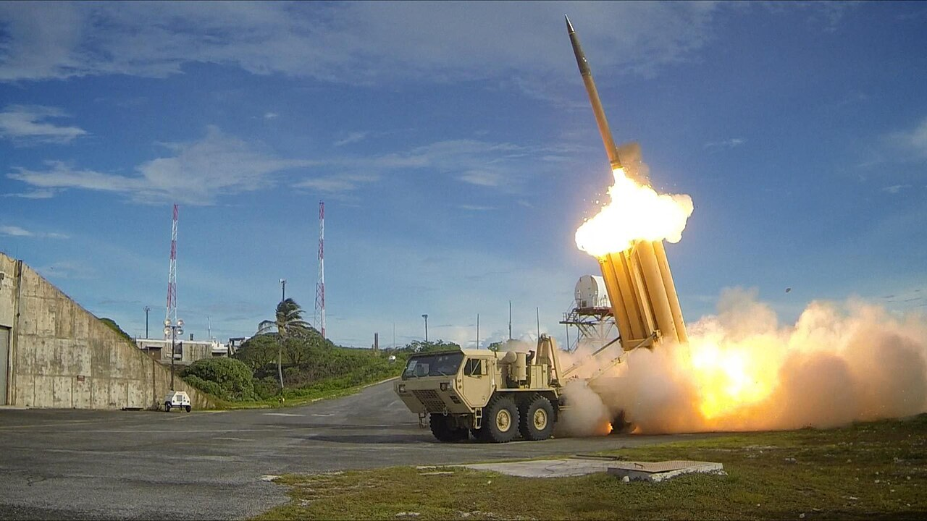
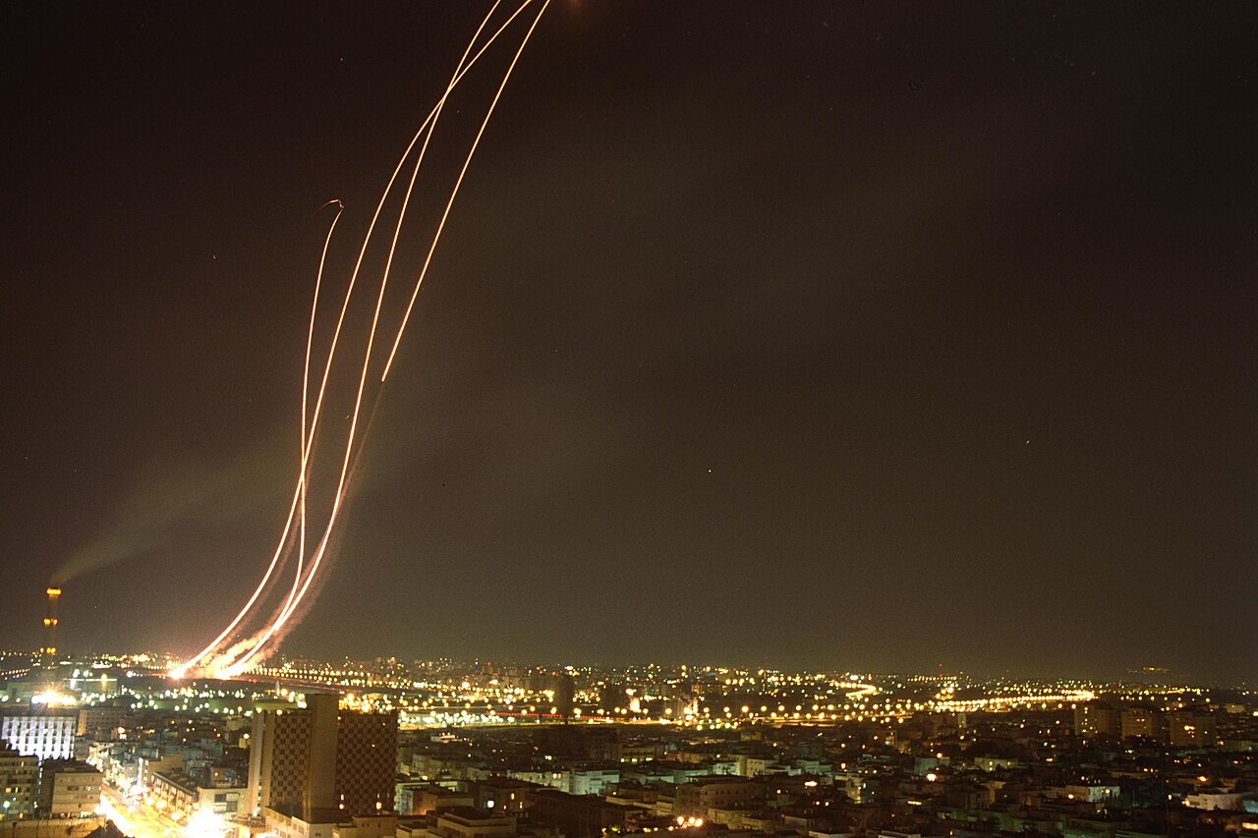
THE DRIVER
Why the imported model is finished
Saudi can no longer afford imported security, and the US will not subsidise it cheaply any more. That is why localisation is fiscally compelled, not simply a sovereign choice.
The Iran wars exposed the arithmetic. June 2025 and the far larger war of Feb 2026 struck Saudi oil facilities and Riyadh. At roughly 100 to 1 per shot, a ~$4m Patriot round to kill a ~$35k drone, attrition is unwinnable; the fiscal cost proved unsustainable within weeks.
SAR 277bn
the 2025 deficit, fully debt-financed; the budget plans deficits every year out to 2028
~100:1
a multi-million-dollar interceptor against a drone worth thousands
SAR 1,667bn
public debt, 34% of GDP (Q1 2026), up from ~5% in 2015 and climbing
620 → 730
Camden built 620 PAC-3 interceptors in all of 2025; Saudi's Jan 2026 order alone was 730
~100%+ of GDP
an analytical proxy, not an official ratio: add state-directed private credit (~69% of GDP) and off-balance-sheet PIF and megaproject debt to the 34% headline and the state-linked leverage is far larger
THAAD launch · US Army (public domain)
Patriot launch · Israel GPO (CC BY-SA)
Sources. Saudi MoF (2025 deficit; Q1 2026 debt); FSDP/SAMA (private credit ~69% of GDP; banking assets ~97%); Globe & Mail (interceptor costs); Lockheed/US FMS (620 vs 730). The 2026 war is reported current events.
From Importer to Integrator · CJRES 2026, St Catharine's College
6
Notes:
Reworked pivot and driver together, framed as affordability, not 'arithmetic'. Saudi cannot afford imported security and the US will not subsidise it cheaply; localisation is forced. Fiscal facts: the 2025 deficit was SAR 277bn, fully debt-financed, with the budget planning deficits every year out to 2028. Headline public debt is SAR 1,667bn, only 34% of GDP, which looks modest, but that is the tell of the argument: with no autonomous private sector, the state-directed private credit (~69% of GDP, banking assets ~97% of GDP) plus off-balance-sheet PIF and megaproject debt is effectively the state's own leverage, so the real figure is near or above 100% of GDP. Dropped the Aramco-dividend detour. The Iran wars proved the ~100:1 attrition economics; Saudi lost fiscally and declined the war. Geography line dropped, photos restored.

Slide 7
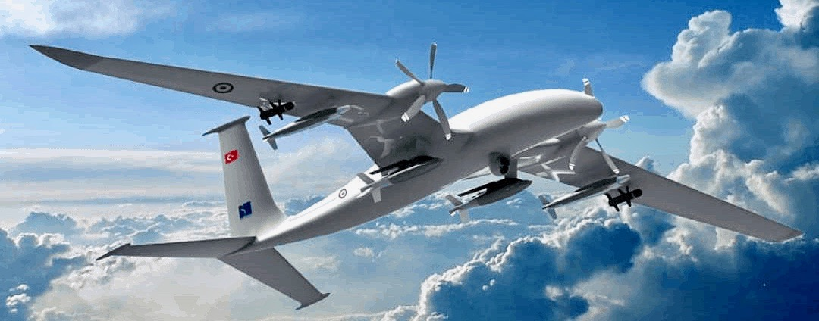
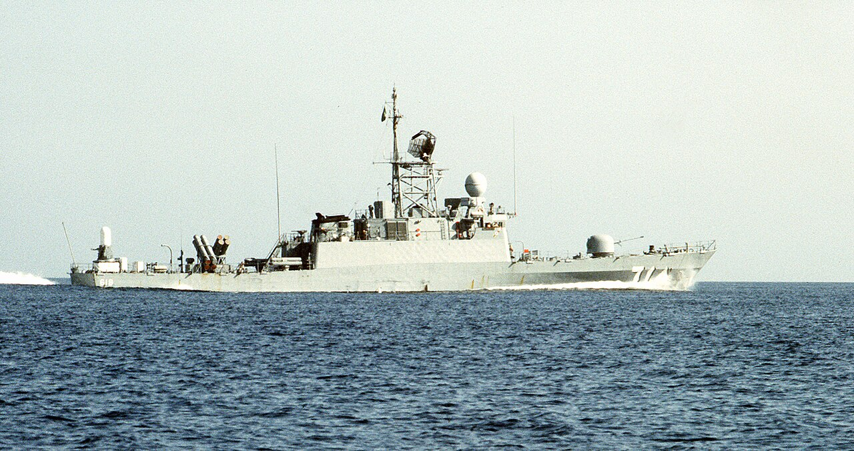
1
MECHANISM 1
Governing defence through financial logics
GAMI runs the sector by target. Localisation 4% (2018) to 24.89% (2024), goal 50% by 2030; 572 GAMI permits and licences (2024); an estimated ~$20.7bn of 2025 spending retained in-country. Any supply contract over ~SAR 150m (about $40m) must localise about 60% and create Saudi jobs, the Industrial Participation rule. The sector employs >34,000 (64% Saudi), targeting ~100,000 jobs by 2030.
What is actually made locally
Bayraktar Akıncı drones · assembly under Baykar · low/mid
THAAD launcher parts · component fabrication · low
Ammunition (>60% local) · mass assembly · low/mid
Bayraktar Akıncı, assembled under Baykar · CC BY-SA
Royal Saudi Navy missile corvette · US Navy, PD
But where is the value? Almost all in low-value assembly, MRO and ammunition, not design. On the value ladder, MRO and assembly are the strong rungs; systems integration is selective (Hazem on a Navantia hull); critical subsystems and design stay foreign, the rungs Turkey and Israel already hold. Capture without capability.
Corvette combat systems (Hazem) · integration on a foreign hull · mid
Aircraft MRO (Alsalam, 75% local) · maintenance · low
Sources. GAMI (Budget Forum 2026; localisation end-2024); GAMI Industrial Participation Policy (60%); SAMI CEO (Arab News, Feb 2026); Soubrier, ISPI (2025).
From Importer to Integrator · CJRES 2026, St Catharine's College
7
Notes:
Mechanism 1: governing by indicator, the governance-technology point. GAMI's KPIs, licensing and the Industrial Participation rule (contracts >$40m must localise ~60% and create Saudi jobs) make the sector legible and directable, and convert foreign contracts into local jobs (>34,000, target 100,000 by 2030). But the value ladder shows capture without capability: assembly/MRO/ammunition, not design; subsystems and IP stay foreign.
Note on the ~$20.7bn retained in-country: this is a derived estimate, roughly the 2025 military budget times the 24.89% localisation share, not a standalone GAMI disclosure. Be ready to show the arithmetic if challenged.

Slide 8
2
MECHANISM 2
The financialised soldier
Paid from oil rent before, bound by finance now. With the oil revenues shrinking vs spending, the state binds the officer and the conscript, and their whole household, into the financial system.
EVERYTHING BECOMES A FINANCIAL PRODUCT
Salary. paid through the banking system, not a cash handout
The payoff: coup-proofing
A financialised soldier has more to lose from disorder. His home, savings, salary and pension are all claims on the same system. Moving against it, or seizing and selling the oil, would wreck his own financial future, so he would face a short-term loss many would be reluctant to take. Loyalty is no longer bought with a handout, it is capitalised. Financialisation may reinforce coup-proofing by binding military households to state-managed financial circuits more cheaply than coercion, and it repositions the citizen from a claimant on the state into an indebted, self-managing subject who has to protect the order that holds his money.
Pension. increasingly market-invested via state vehicles, not a pure treasury promise; military and civil funds merged into GOSI (2021), invested by Hassana (~SAR 1.2tn) in Tadawul equities and sukuk
Home. a REDF sharia mortgage from a commercial bank. Rent Now Pay Later
Insurance. compulsory motor and health, the bulk of a ~SAR 71bn market (2025)
School fees, the car, purchases. instalments and BNPL (Tabby ~15m users across its markets, Tamara's Study-Now-Pay-Later)
Loyalty is capitalised, not bought.
Household debt ~31.6% of GDP (broad measure) · 85% of payments electronic · the whole household drawn in.
Sources. GOSI/Hassana (2021 PPA merger; ~SAR 1.2tn); REDF/Sakani; Insurance Authority/SAMA (compulsory lines); Tabby/Tamara (2025-26); SAMA (e-payments 85%); household debt ~31.6% of GDP on a broad measure, narrower measures much lower. The coup-proofing synthesis is the author's argument.
From Importer to Integrator · CJRES 2026, St Catharine's College
8
Notes:
Mechanism 2: making financial subjects, and coup-proofing through it. The soldier's salary, pension (GOSI/Hassana market-invested since the 2021 merger), home (REDF mortgage), insurance (compulsory), and even school fees and car (BNPL/finance) are all financial products, the whole household financialised (85% e-payments, household debt 31.6% of GDP). The payoff, in the author's words: a financialised soldier cannot miss a bill; acting against the system costs him everything, so he protects it; loyalty is capitalised; money coup-proofs more cheaply than guns. Documented plumbing; the coup-proofing synthesis is the author's original contribution.

Slide 9
3
MECHANISM 3
Defence as an asset class
Follow the money. No defence firm is listed, so value comes from the state's balance sheet, not a share price. It is made an asset three ways.
Joint ventures
SAMI's operating divisions are joint ventures with foreign primes, Navantia, GDLS, Airbus, MBDA, Lockheed, L3Harris, Thales. Capability is packaged as co-owned corporate equity vehicles, financed and booked as assets, rather than bought off the shelf.
1
SAMI, created and leveraged
The state built SAMI (2017) as its PIF champion and had it borrow, ~$1.8bn from three Saudi banks in 2022, a first for the sector. It reports revenue rising to ~$1.44bn but discloses no profit; the value sits on the state's balance sheet and PIF ownership.
2
Listed companies, through contracts
Ordinary listed suppliers must disclose their defence contracts under CMA rules, Anmat (MoD IT, SAR 37m), Tibbiyah (National Guard health, SAR 129m), so the defence budget surfaces in the capital market and feeds bank credit. The first defence VC fund, MASNA ($100m, 2026), and the state-run World Defense Show sit on top.
3
Sources. SIPRI/Breaking Defense (SAMI revenue); Arab News (2022 bank facilities); Tadawul/Argaam (Anmat Jul 2026, Tibbiyah Jan 2026); Semafor (MASNA, Feb 2026); Al Defaiya (WDS 2026, GAMI-run).
From Importer to Integrator · CJRES 2026, St Catharine's College
9
Notes:
Mechanism 3, rebuilt around the three real means of making defence an asset class: (1) JOINT VENTURES, SAMI's divisions are JVs with Western primes, capability packaged as co-owned equity vehicles; (2) SAMI CREATED AND LEVERAGED, the state built SAMI in 2017 and had it borrow ~$1.8bn (2022); value sits on the state balance sheet, no disclosed profit; (3) LISTED COMPANIES THROUGH CONTRACTS, ordinary listed suppliers disclose defence contracts under CMA rules (Anmat, Tibbiyah), so the budget surfaces in the market, with MASNA and the state-run World Defense Show on top. Household loop removed, it is already in Mechanism 2.

Slide 10
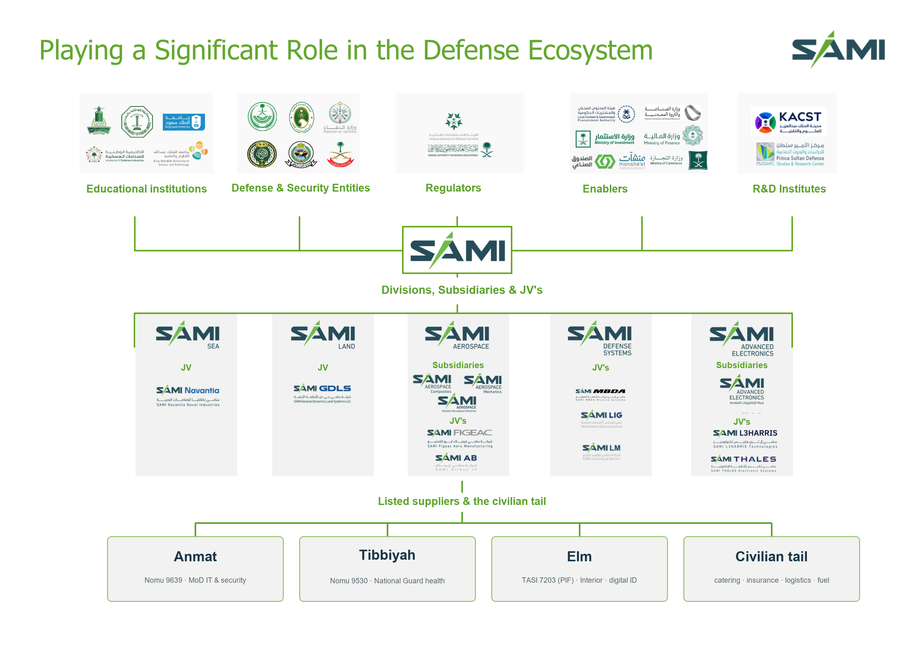
THE GEOGRAPHY · THE NETWORK
SAMI's map of the defence ecosystem
SAMI Corporate Presentation, April 2024 (p.3). The bottom row of listed suppliers is added by the author; the rest is SAMI's own diagram.
From Importer to Integrator · CJRES 2026, St Catharine's College
10
Notes:
SAMI's own ecosystem diagram from its April 2024 corporate presentation, reproduced exactly, then extended. Read it straight: the ring of state bodies (educational institutions, defence and security entities, regulators, enablers, R&D institutes) on top; SAMI the hub; and the row of operating divisions, each a joint venture (Navantia, GDLS, Airbus/Figeac, MBDA, LIG Nex1, L3Harris, Thales) or subsidiary. My one addition is the bottom tier: the local listed suppliers and civilian tail (Anmat, Tibbiyah, Elm and the rest) that carry the non-defence side, showing how the defence budget is recycled back to the state through Tadawul, the banks and GOSI/Hassana/PIF.

Slide 11
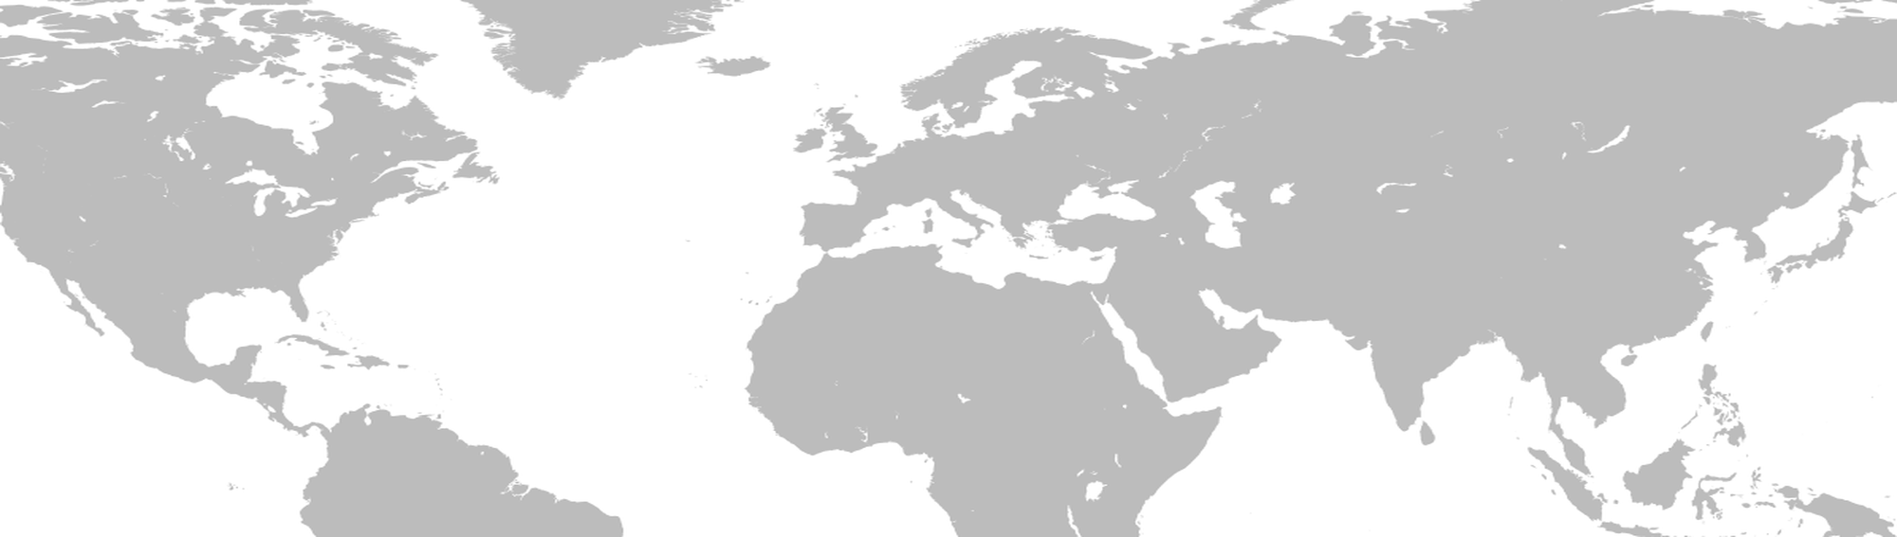
THE GEOGRAPHY · GLOBAL
Hedging across three fighter paths, US, Europe and Turkey
United States
New: F-35 x48 (~$5.5bn), 300 Abrams, Dec-2025 defence pact. Existing: F-15SA, Patriot, THAAD, 730 PAC-3 ($9bn). ~$142bn headline.
United Kingdom
72 Typhoons, ~48 more mulled. Leads the GCAP 6th-gen fighter; backs Saudi joining (royal visits, Feb 2026).
Germany
Embargo lifted: 150 IRIS-T missiles cleared and the 48-jet Eurofighter sale unblocked.
Ukraine
Counter-drone co-production pact (Mar 2026), the deal with real technology transfer.
China / Russia
Shallow. No pact; the S-400 never closed; non-integrable with a US-built force.
South Korea
M-SAM II 'Cheongung-II' hit-to-kill air defence, $3.2bn (2024); Hanwha radar $0.87bn.
Saudi Arabia
Spain
Navantia Sarawat corvettes: 5 delivered + 3 building (~EUR 2bn), finished in-Kingdom.
France
54 Rafale requested (talks, not closed); naval, air-defence and satellite deals signed.
Italy
$10bn defence pact (2025); Leonardo fighters + ~20 NH90 (~EUR 2bn); GCAP partner.
Turkey
Deepest tie: KAAN (up to 100, talks), Gokbey built in-KSA, Roketsan missiles, GHOST drones. ~$6bn reported.
Pakistan
Mutual-defence pact (Sep 2025), 'aggression on one is aggression on both'. The one real guarantee.
Sources. White House/SPA (US, Nov 2025; F-35, SDA, $142bn); UK Gov/Bloomberg (GCAP, Feb 2026); Dassault/Elysee (Rafale); German Gov (IRIS-T, Eurofighter); Navantia (Sarawat corvettes); Leonardo (NH90, $10bn); Turkish Aerospace/Roketsan (KAAN, Gokbey, WDS 2026); LIG Nex1/Hanwha (M-SAM II, $3.2bn, 2024); Ukraine Presidency (2026); Al Jazeera (Pakistan, Sep 2025).
From Importer to Integrator · CJRES 2026, St Catharine's College
11
Notes:
Global partnerships on the world map (restored), with located callout clouds at each country dot and leader lines. US anchor privileged but capped (MNNA and SDA with no guarantee, $142bn aspirational, F-35 unsigned). Europe rebuffed (GCAP deferred by Japan, falls back on Typhoons; German IRIS-T; French Rafale). Ukraine now its own callout, a 10-year counter-drone co-production pact (Jeddah, Mar 2026), the one deal with real technology transfer. Turkey the deepest tie (KAAN co-investment talks). Pakistan the one real mutual-defence pact. Korea air defence. China/Russia shallow. The line: hunting higher-value Western partners and mostly rebuffed, managed dependence.

Slide 12
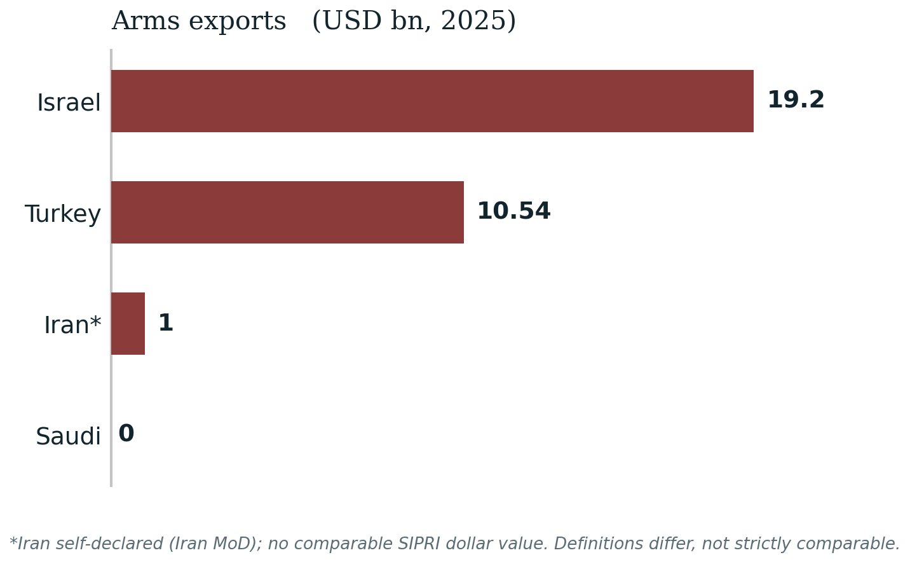
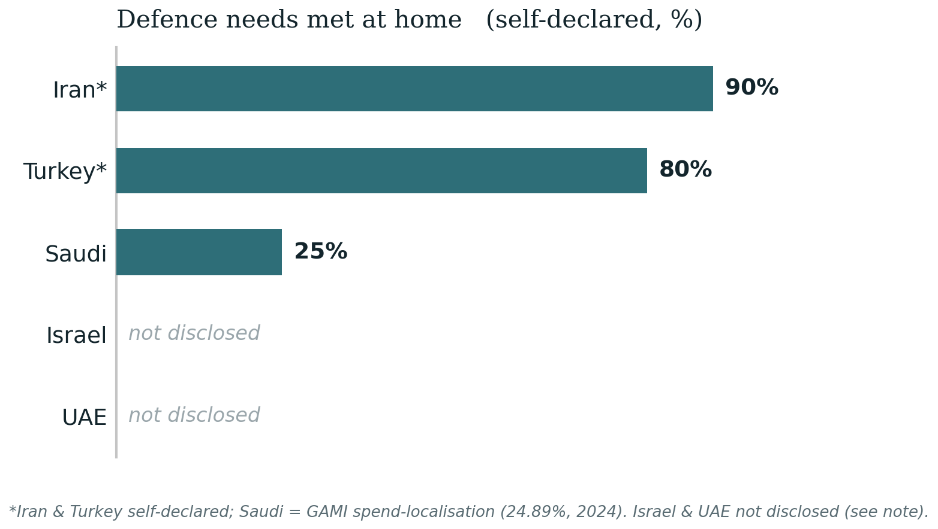
THE GEOGRAPHY · REGIONAL
A crowded neighbourhood. Biggest spender, smallest producer
Biggest budget, lowest rung. Nine Middle-East firms sit in the SIPRI Top-100, none Saudi. On home content the picture is uneven: Iran claims ~90% and Turkey ~80% (self-declared), Saudi ~25% (GAMI spend-localisation); Israel and the UAE disclose no figure. Israel is the one to watch, ~$108bn over a decade (Dec 2025) for weapons independence and a move to privatise Rafael, though it still imports its fighters; the UAE builds fast through EDGE (~$20bn backlog) but still imports major platforms, so likely near Saudi overall. Against Iran's cheap mass Saudi loses on numbers, capture without capability.
*Iran exports ~$1bn self-declared (Iran MoD); no comparable SIPRI dollar value. Israel ~$19.2bn exports (SIBAT 2025). Turkey ~$10.54bn (SSB 2025). Home content: Iran ~90% & Turkey ~80% self-declared (Iran Army; SSB); Saudi 24.89% (GAMI spend-localisation); Israel & UAE not disclosed. Sources. Netanyahu ~$108bn/decade Dec 2025 (JPost/Times of Israel); Rafael privatisation (TheMarker); UAE EDGE $20.4bn backlog (Gulf News); SIPRI (2021-25); SIBAT; SSB.
From Importer to Integrator · CJRES 2026, St Catharine's College
12
Notes:
The test, told through two charts only, the regional map dropped (the global map already carries the geography). Saudi is the region's biggest spender but the smallest producer: zero exports, no SIPRI Top-100 firm, lowest home content (~25% vs Turkey/Iran/Israel 80-90%). Exports chart uses Iran (self-declared) in place of the unsourced UAE figure. Israel added with Netanyahu's ~$110bn/decade drive, flagged as estimate. Capture without capability, the defence analogue of the education paper's labour-market failure.

Slide 13
CONCLUSION
Managed dependence. Building power, not conceding it
Financialised, not substituted. Defence is folded into the wider financialisation of the state, the same governance move applied to the security core.
Finance is the method, regime security the purpose. Financialising the soldier may reinforce coup-proofing; money coordinates control more cheaply than coercion.
Path-dependent, from zero. Saudi starts from a thin industrial base; it uses capital to compensate for that, a decades-long climb, so it hedges through Western JVs while its systems stay US-built.
The bill goes unpaid. Localisation stays shallow, exports are negligible, and the fiscal ground is sinking under debt.
A military-industrial complex without a military-industrial constituency, a ledger without a market. Can a system built to contain autonomy ever produce it? MBS gets to stay king.
Ahmed Alqarout · University of Exeter
From Importer to Integrator · CJRES 2026, St Catharine's College
13
Notes:
Conclusion on the three-mechanism spine. Defence is financialised, not substituted; finance is the method and regime security the purpose (the financialised soldier is the coup-proofed soldier); it is path-dependent from zero, so Saudi hedges through Western JVs while its systems stay US-built; the bill goes unpaid, localisation shallow, exports zero, fiscal ground sinking. A military-industrial complex without a constituency, a ledger without a market. Contributions: to financialisation theory (a defence variant of state-led financialisation), to the state-capitalism debate (one state as investor, regulator, customer, integrator), and to arms geography (a Gulf producer building autonomy through financial circuits).

Slide 14
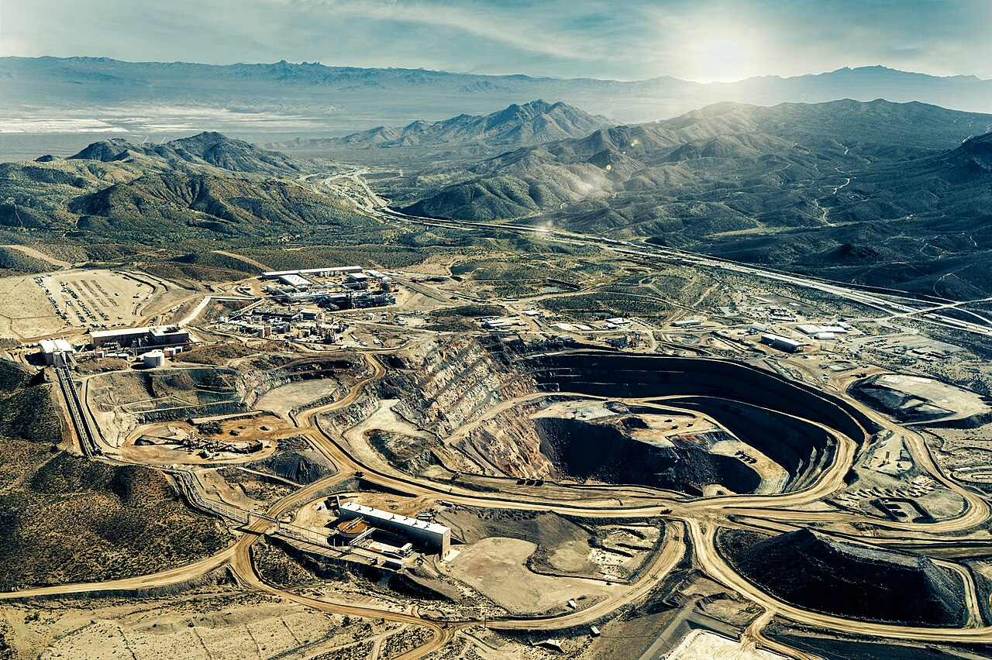
BACKUP · CASE STUDY
Rare earths, one PIF ecosystem, not a civilian venture
PIF wholly owns SAMI and controls a majority stake in listed Ma'aden, so the miner and the arms champion answer to the same owner, in defence-adjacent strategic supply chains.
Mountain Pass rare-earth mine · CC BY-SA
1
Ownership
2
Market
3
Stake
Ma'aden is PIF's listed, PIF-controlled miner, the same PIF that wholly owns SAMI, holding >=51% of a new rare-earth refinery. Ownership stays inside the PIF perimeter.
MP Materials brings the technology; the US Department of War finances the 49% foreign side non-recourse, a Pentagon-funded, China-countering supply chain.
Abroad, Manara Minerals (Ma'aden-PIF) took 10% of Vale Base Metals for $2.5bn (2024), securing minerals through an equity stake, not a mine.
Then projection. A separate $9bn Burkhan minerals MOU (2025) has, per Semafor (single source), pivoted to sourcing minerals for Iran's postwar reconstruction, the same financialised-minerals capacity turned into regional statecraft.
Sources. MP Materials (Nov 2025); Vale/Manara (Apr 2024); Semafor (Jun 2026, single outlet). Refinery site undisclosed.
From Importer to Integrator · CJRES 2026, St Catharine's College
14
Notes:
Backup, use only if time. Rare earths compress the argument: ownership (PIF/Ma'aden, same owner as SAMI), market (MP Materials + US Dept of War non-recourse finance), stake (Manara/Vale equity), then projection (the Burkhan/Iran-reconstruction pivot, single-source Semafor, flag it).

Slide 15
BACKUP · THE REGULATOR'S OWN WORDS
What the regulator commits to, in its own words
Primary sources, GAMI's own published policies (2023-25). De jure architecture, not audited outcome; the offset ledger's actual redemption volumes are not disclosed.
Offset credits as a state-issued currency. A 60% local-content floor on any contract above ~$40m, secured by a 10% on-demand bank performance bond, with GAMI keeping the credit ledger and able to draw it down to fund research. Industrial Participation Policy; R&D Regulation Art 32(b).
The state harvests the intellectual property. Government funding, full or partial, transfers IP ownership to GAMI; the nominal owner may not register abroad, sell, licence, produce or export without GAMI's consent. R&D Regulation Arts 44-45.
Data as sovereign territory. Confidentiality by default, in-Kingdom data residency with no offshore processing without GAMI approval, and 'Saudi Eyes Only' as a formal circulation class. Data Management & Security Policy Arts 5, 7, 9-10.
A discretionary export veto. GAMI may refuse any permit and cancel one for 'public interest or national security', with catch-all end-use control even over unlisted goods. Import & Export Control Policy Arts 4, 10-11.
Listing rewarded over family ownership. A listed company can change hands without re-triggering licence review; a private firm cannot, an incentive to go public buried in the fine print. Licensing Regulations 2.12.
From Importer to Integrator · CJRES 2026, St Catharine's College
15
Notes:
Backup, primary-source evidence for Mechanisms 1 and 3. GAMI's own regulations, read page by page: offset credits function as a state-issued currency (60% floor, 10% on-demand bond, offset drawn down to fund R&D); government-funded IP vests in GAMI and cannot be moved without consent (R&D Arts 44-45); data is held in-Kingdom with Saudi Eyes Only; exports face a discretionary veto; and listing is quietly rewarded over private family ownership (Licensing 2.12). De jure design, not audited outcome.

